Slide 1

Eating for results

Slide 2
Nutrition for Riders- in training and competition
Rebecca Disher
Accredited Practising Dietitan
Advanced Sports Dietitan

Slide 3
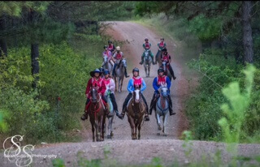

Session Overview
Nutrition- why is it important
What are Fuelling foods?
What are Muscle repair/building foods?
The When, What, and Why of fueling
Dehydration- what is it?

Slide 4
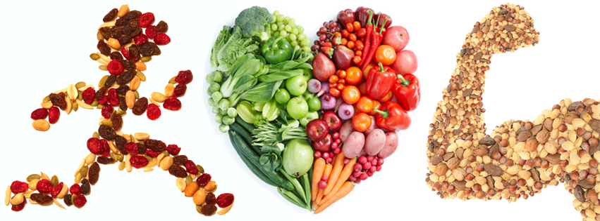
Why is nutrition important?
Fuel for your body
Energy for life
  Muscles
  Brain
  Body processes
Boosts immune system
You can’t live without it!

Slide 5
Its Quiz Time!
Athletes and coaches:
  Everyone is going to be tested on their nutrition knowledge
  I will ask a question
  You are going to put your hand up for the answer you think is correct
  There are 3 answers A, B or C

Slide 6
Question
Your brain exclusively uses the following fuel to think:
Protein
Fat
Carbohydrate

Slide 7
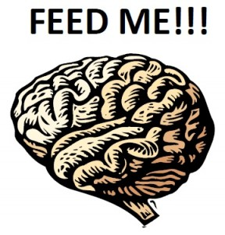
Answer
C. Carbohydrate
Fuel foods rich in carbohydrate are the brain’s preferred source of energy.

Slide 8
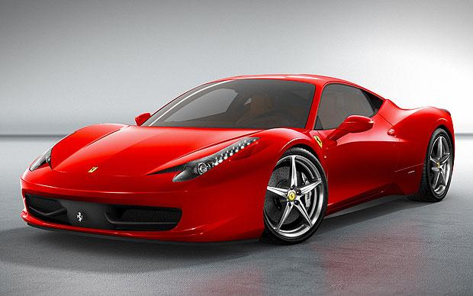


Your body’s fuel
Does anyone know how we measure energy?
Notes:
Does anyone know how we measure energy? Energy = kJ or calories.
Energy is the value that we see on the back of product labels. It can usually be expressed as either kJ or calories.
We are like cars. We need petrol to function. It depends on what kind of car you want to be. If you want to be an amazing pink convertible then you want to fill yourself with good petrol ie energy. However, if you decided this is not a priority then you’ll probably end up with a pretty run down machine like the one here on the left.

Slide 9
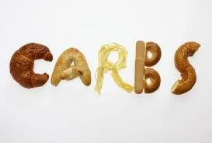
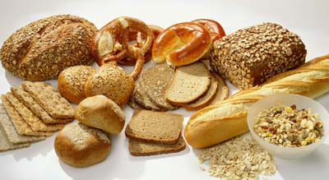
‘Fuelling’ Foods = Carbohydrates
The most important energy source!
Our brain cannot function without carbohydrates
Neither can our muscles!
Only a small amount of carbs can be stored in our body – in the blood stream, in our muscles & in our liver

Slide 10
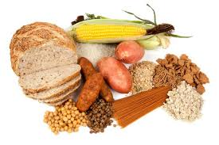
Carbohydrate Rich Foods
Breads, bread rolls, wraps
Breakfast cereals
Pasta, rice, noodles, quinoa
All fruit (whole, juiced, tinned)
Starchy Vegetables – potatoes, taro and corn
Legumes – baked beans, kidney beans, lentils
Cereal, muesli and breakfast and muesli bars
Dairy foods (milk, yoghurt, custard)
Pancakes, crumpets, scones, muffins

Slide 11
What happens when we do not eat enough ‘fuelling’ foods?
No energy!
Every day life: general fatigue/tiredness, have trouble concentrating at school/uni/work, poor mood, lack of growth
Sports and activities: poor recovery, early fatigue in training and events, perhaps headaches and nausea
Notes:
Your brain will have no energy to think, to make good decisions on the pitch, to listen to your coach, to know whether the ball is coming! Imagine the goalie not concentrating on the game – score for the opposing team!

Slide 12
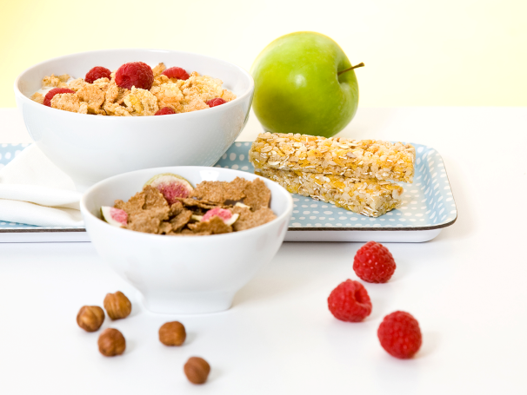
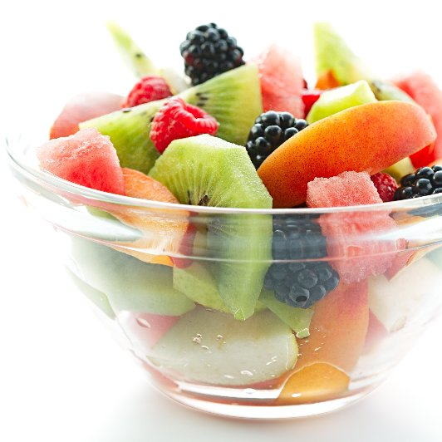
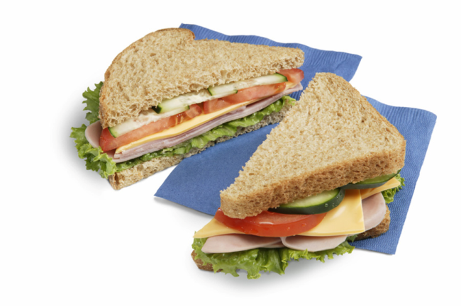
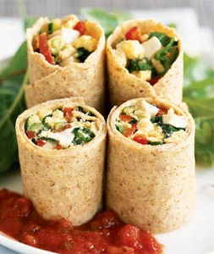
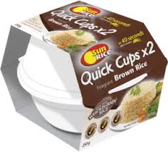
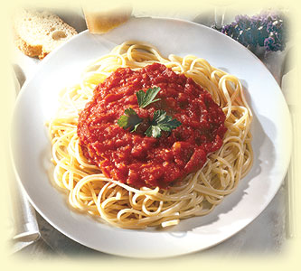
Quality ‘fuelling’ foods for training and competitions
Notes:
Use carbohydrates that feature on the Australian Guide to healthy eating as the basis of your carbohydate choices eveyrday

Slide 13
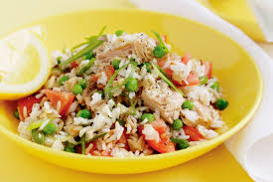
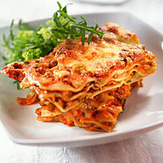

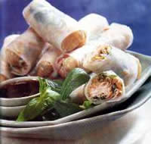
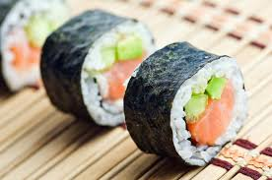
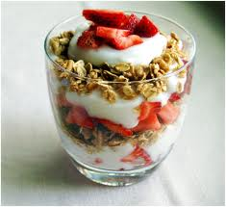
Quality ‘fuelling’ foods for training and competitions

Slide 14

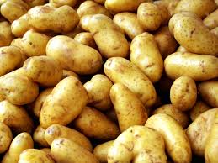

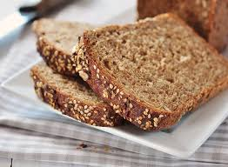
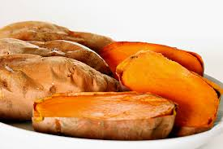
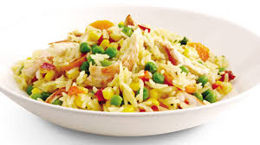
Quality ‘fuelling’ foods in competitions when camping

Slide 15
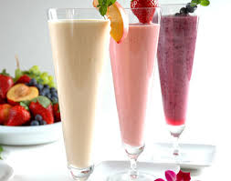
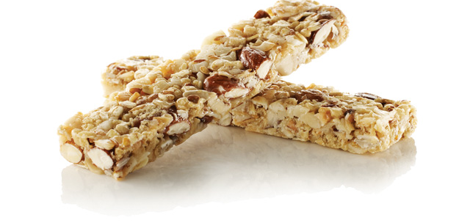
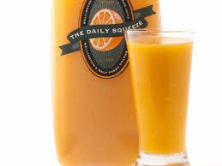
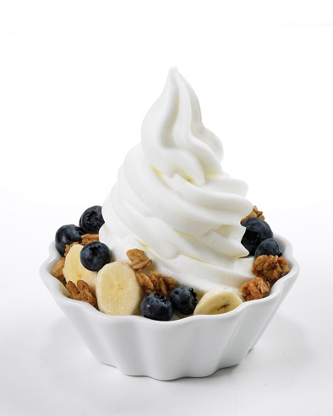
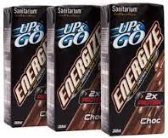
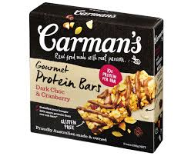
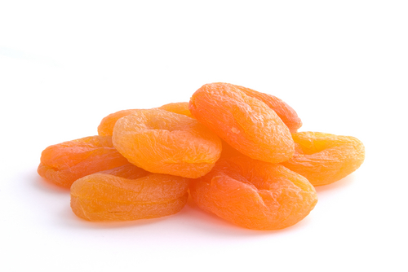
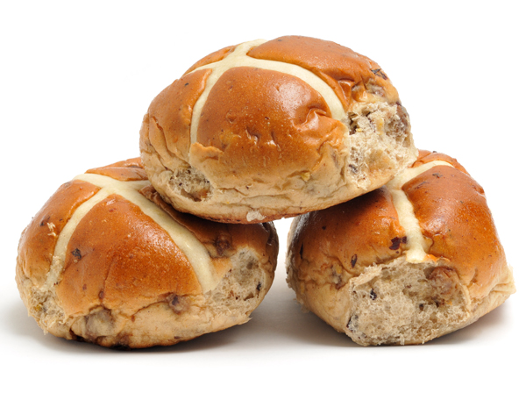
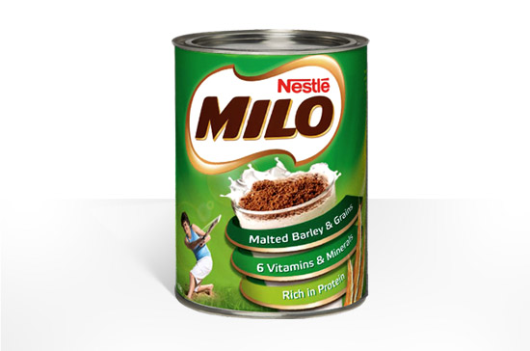
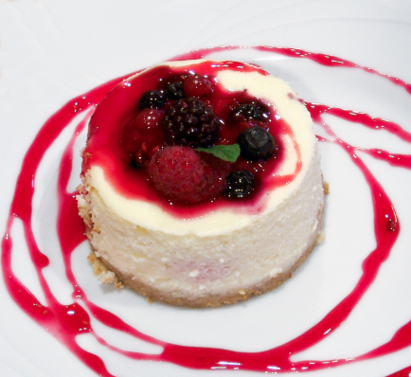
We also find them in drinks, snacks and desserts

Slide 16
Question
How many hours before training is it best to have a fuelling snack or meal,?
Whenever the athlete can!
3 hours
1 hour

Slide 17
Answer
A. Whenever the athlete can!
Most feel more comfortable with 1-2 hours digestion time, but even if you only have a few minutes you can still use the energy.
For example, if you finish school/uni/work at 3pm and have training at 3.30pm eat/drink as soon as you finish school. Liquids work best for short timeframes.

Slide 18
Eating Before Training/Competitions
Why?
To top up energy stores
To help you train and preform at your best
To help you concentrate on learning new skills

Slide 19
Eating Before Training/Competitions
When?
Best to eat when practical within the 2-4 hours before session, especially if starting at midnight!
Depends on the time, duration and intensity of activity, environment, training status, frequency of sessions
Can rearrange meals to suit training times
Notes:
E.g. Fuelling up for afternoon session
Big breakfast
Include something cooked
Lunch
Pasta, noodles, rice
Sandwiches/rolls/wraps
Sushi
Plus fruit/muffin/yoghurt
Afternoon pre-training snack
Sandwich
Plain pasta/noodles
Fruit
Bar/muffin
Sustagen

Slide 20
Eating Before Training/Competitions
What?
Choose foods easy to digest, rich in carbohydrates, moderate protein and fats and that are enjoyable!
Aim to prevent hunger yet avoid GI upset
Practise is key. Find what works best for you!
NEVER TRY ANYTHING NEW ON COMPETITION DAYS
Notes:
Everyone will be different - as much as you require to meet your needs and suit training type, frequency.
Choose foods convenient to suit pre training engagements.

Slide 21
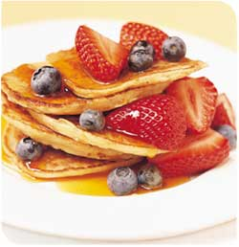
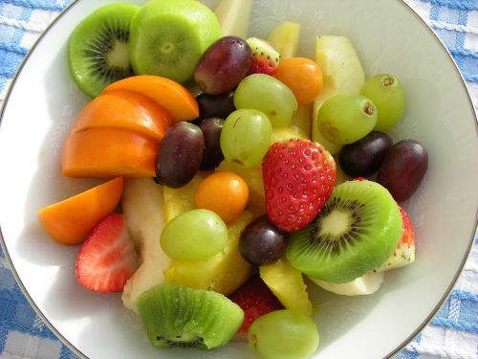
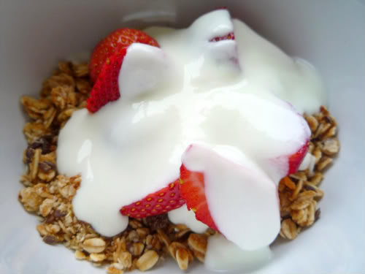
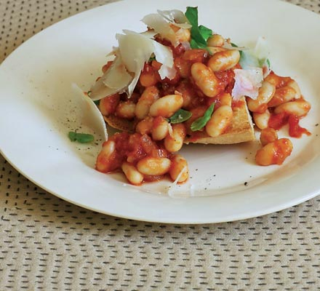
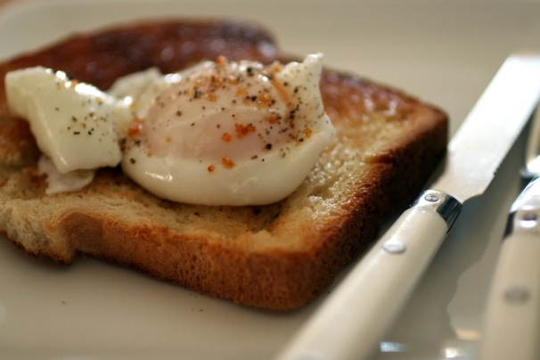
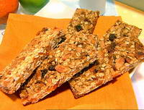
Breakfast Ideas
Notes:
21

Slide 22
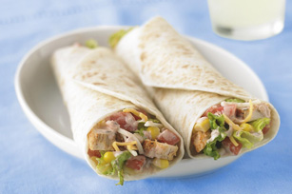
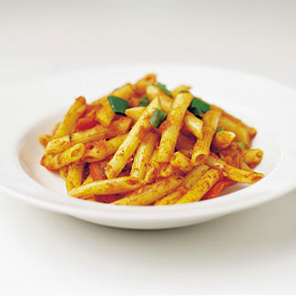
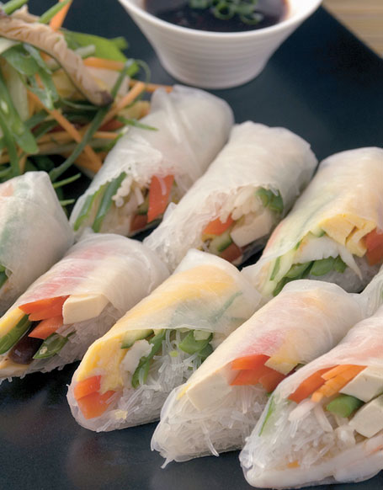
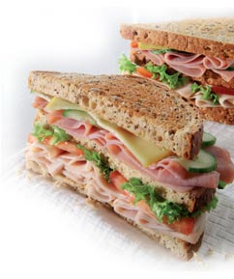
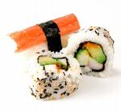
Lunch Ideas

Slide 23
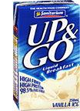
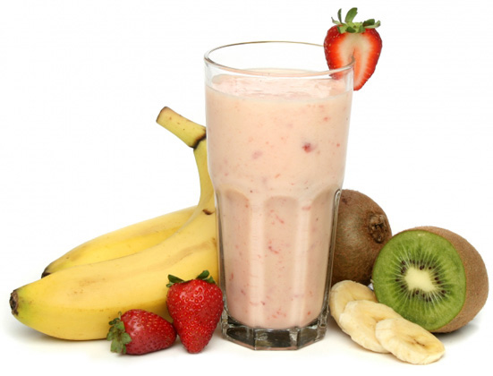
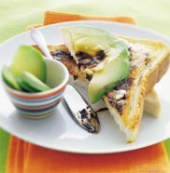
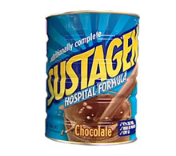
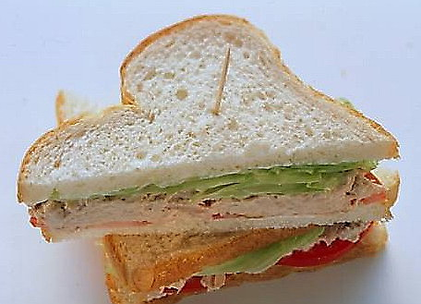
Snacks
Notes:
Some athletes that have high energy requirements find that to get the required energy they need they are eating 24hrs a day and there is not much time for anything else.
Therefore these athletes need to be as dedicated to eating correctly as they are to training.
They must have food available at all times to ensure that they are consuming enough food to meet their energy needs. This means being organised.
Organise your eating plan around your schedule. If an athlete is organised they find that fitting in time to eat does not seem to be as much of a chore.

Slide 24
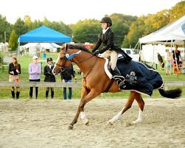
Eating Before Training/Competitions
Other easy examples:
Serve of fruit
Rice cakes or grain crackers + peanut butter
Slice of toast + cheese and tomato
Small handful of dried fruit
Smoothie
Half a standard meal or leftovers

Slide 25
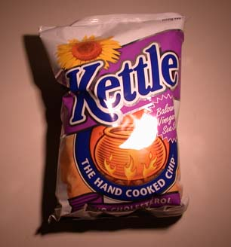

Snack comparison
=
2 200 kJ
7 g protein
33 g fat
50 g carbohydrate
2 200 kJ
25 g protein
5 g fat
95 g carbohydrate

Slide 26



Protein foods = muscle foods

Slide 27
Where do you find protein?
Animal Sources
2 small eggs
1 cup low fat milk
35g lean beef, lamb or pork
40g lean chicken
200g reduced fat yoghurt
50g grilled fish
30g reduced fat cheese
Plant Sources
4 slices wholemeal bread
3 cups wholegrain cereal
2 cups cooked pasta
3 cups cooked rice
200g baked beans
60g nuts or seeds
¾ cup lentils or kidney beans
~ 10g protein

Slide 28
How much protein does any athlete need?
Minimum 1-2 serves per day
One serve is equal to:
65-100g cooked meat or chicken
80-120g cooked fish
2 eggs
1/3 cup cooked beans, lentils or chick peas
1/3 cup almonds
BUT!
You must take into account the amount of exercise and its intensity
Notes:
65-100g is equivalent to: 1/2 cup mince or 2 slices roast meat
Getting enough protein each day is not difficult. We meet our protein requirements easily through regular meals and snacks. Vegans may have trouble.
If eating more than 1 serve of protein per day, you may be filling up on protein and missing out on lots of the other food groups that you require each day. Remember that red meats can be very fatty, so if you are eating many serves of these you can be adding lots of extra kilojoules to your diet which may contribute to weight gain. Always try to purchase LEAN meats and always trim the fat off and peel the skin off the chicken.
If more protein is eaten than is required the excess protein is probably stored as body fat (but NOT muscle!)
Protein is a very filling food, so it’s a good one to help you stay feeling full and satisfied for long periods. Snacking on protein foods such as a small handful of nuts or a tub of yogurt are good snack options to keep you going to your next main meal.

Slide 29
Protein for your muscles
Very important nutrient for growth
Helps to maintain, rebuild and repair all of our muscle tissues
Children require more protein than adults
Athletes require slightly more protein, especially those who are growing (adolescents) or undertaking a strength program

Slide 30





Tips for building strength
Goal: increase strength and power and muscular endurance
Support training through:
  ‘Muscle’ foods
  30-60 minutes after ALL sessions:
    300ml Sustagen/liquid meal replacement
    300ml milk
    1 high protein yoghurt
    350ml Up & Go ‘Energize’
    2 eggs or slice of lean meat

Slide 31


TO BUILD MUSCLE…
Muscular strength – the force a muscle can exert against a resistance, i.e. pulling up a strong horse.
Muscular endurance – the ability to use voluntary muscles repeatedly without fatigue, i.e. remaining in two-point position for an entire course/several horses.

Slide 32




YOU ALSO HAVE TO TRAIN HARD

Slide 33




AND EAT PLENTY OF FUELLING FOODS

Slide 34




Muscle foods

Slide 35





It doesn’t have to all be meat and dairy

Slide 36





Put some protein into each meal
Protein also helps to keep you fuller for longer and many protein foods contain
iron, zinc, B12 & many
other important
nutrients!

Slide 37





A ‘muscle’ food snack is important after training sessions AND ALL competitions

Slide 38
Eating DURING Training/Competitions
Why?
THE 3 R’s
Restore muscle and liver fuel stores
Replace fluids and electrolytes
Repair and adaptation processes
Notes:
Allow you to maximise performance, minimise down time/injury and manage multiple training sessions/games per week.

Slide 39
Eating During Training/Competitions
When?
Your body burns 1g of glucose per MINUTE with high intensity efforts… therefore FUELING foods need to be consumed regularly
As soon as possible to hit protein synthesis window (preferably within a the 1st hour)
Be realistic about what is needed to suit your training and goals
Depending on your competition/s time, types of food/drink needed can vary greatly therefore PREPARING and PLANNING are essential- especially for tournaments
Notes:
– Factors such as fatigue, loss of appetite, access, post exercise commitments & activities may interfere
- What you require may be different to your team mate

Slide 40

Eating During Training/Competitions
What?
Combination of carbohydrates and protein optimal, small amount of healthy fats
LOW GI vs HIGH GI options
Notes:
Allow you to maximise performance, minimise down time/injury and manage multiple training sessions/games per week.

Slide 41
What is GI?
A low GI carbohydrate raises blood glucose levels slowly over a longer time followed by a gradual decline
Helping to keep blood glucose levels controlled.
Benefit =low GI foods are more satisfying and filling, which is helpful in weight management.
A high GI carbohydrate
releases glucose into the blood stream quickly causing a spike in blood sugar levels.
Pancreas has to work hard to produce the hormone insulin.
Leads to our body storing fat more efficiently, which is not an ideal situation.
Lower GI foods assist in the management of insulin, weight & blood sugar levels.

Slide 42

Glycemic Index

Slide 43
Question
How much water should an equestrian athlete be drinking each day?
100mL per year of age
2L, more if its hot or humid & when training
Drink when they are thirsty

Slide 44

Answer
B. 2L, more if its hot or humid & when training
How do I know if I am hydrated?
    Make sure your urine is clear/pale in colour (1-3)

Slide 45
Time | What to drink
During the day for general hydration | Water
During training | Water +/- Sports Drink (if really hot only)
After training | Water Milk-based drink
Competitions | Water Sports Drink Electrolyte Drinks (hydralyte)
Notes:
During the day – water is sufficient to keep us hydrated. We don’t want to be consuming sweet sugary drinks during the day as they will only add excess calories to our diet.
It is best to continue to slowly sit on water over the course of the day. Skulling a drink bottle right before the match will not mean you are hydrated - In fact it will probably make you quickly run to the toilet! Our body is better at absorbing water if we gradually sip.
During training/competition – water for session < 60mins
- if greater than 60min duration → of mod-high intensity → Sports drinks:
Sports drinks:
Contains sodium which helps the water to “stick” in your body, helping us to hydrate more effectively.
Contains electrolytes, such as potassium, to help prevent muscle cramps.
Contains carbs (6-8%), good to sustain energy levels throughout long rounds.
After Training:
Replace 1.5 x the kg lost.
Milk based drinks for a great recovery snack:
Contains carbs and protein – a great recovery snack
Good source of protein and calcium for a balanced diet
Remember to choose low fat dairy!

Slide 46
Nutrition and Hydration on competition day
ARE CRUCIAL …….
Foods high in sugar will give you energy spikes, which, along with adrenalin, will just have you yo-yoing up and down all day and crashing in a heap at night.
Your horse doesn’t need your nervousness to be compounded by a sugar spike!
Hot chips, doughnuts, fizzy drinks – or nothing at all – are not suitable foods in general, let alone at competition.
Nutrition Tips: Bring your own food and don’t rely on food at the competition. Planning will save you from starvation.

Slide 47


On the day
Eat your last ‘meal’ ~1-2 hours before your competition…further away if you are nervous!
At that meal top up……
  Muscles (protein foods)
  blood sugar levels (carb foods)
Check your urine colour
Have a snack and drinks closer to the your event (~ 1-2 hours before)

Slide 48
Morning or lunchtime event
Good breakfast
  Cereal with fruit and yoghurt
  Toast with spreads or eggs/baked beans or ham/cheese/tomato toasted
  Up and Go, Fruit blend smoothie or glass of milk
Snack closer to your event
  Sandwich
  Fruit
  Muesli bar
  Sustagen/Up & Go
  Plus plenty of fluid throughout the day – water, juice, perhaps a sports drink on a hot day

Slide 49


If you are too nervous to eat much….

Slide 50






Late night event time
Breakfast
Morning tea
Lunch
Afternoon tea
Dinner
Dessert
Pre- Race snack
  Plus plenty of fluid throughout the day – water, juice, perhaps a sports drink on a hot day

Slide 51
Hydration = water
Dehydration (hypohydration) impairs the body’s ability to regulate heat resulting in increased body temp and can increase heart rate by 7.5%, and just a 2% body weight reduction from fluid loss can decrease performance 20%.
Perceived exertion is increased causing the athlete to feel more fatigued than usual at a given work rate
Mental function is reduced which can have negative implications for motor control, decision making and concentration
Gastric emptying is slowed, resulting in stomach discomfort

Slide 52
Hydration tips
Begin each exercise session in fluid balance. Have a drink with all meals and snacks.
Immediately, before exercise commences, consume 200-600 ml of fluid.
Develop a plan for fluid intake for all exercise sessions longer than 30 minutes. Aim to match previous fluid losses as closely as possible (within 1% of body mass).
Walk your horse early morning or evening to avoid the heat of the day, and wear a good hat.
Each kilogram (kg) of weight lost is equivalent to approximately one litre (L) of fluid to replace!
Research shows that fluid intake is enhanced when beverages are cool (~15 °C), flavoured and contain sodium (salt).

Slide 53


Should I use sports drinks?
  If you are:
  Training very hard (>60mins, high intensity) in hot humid weather
  A very heavy sweater
  Training twice a day (at high intensity)
  Perhaps if you suffer from cramps
  BUT sports drinks should NOT be an every day fluid and always drink with plenty of water!

Slide 54


Sports Drinks & Teeth
Notes:
Drink sports drinks before, during and after exercise only
Drink water as well and rinse your mouth with water regularly
Drink them cold
Limit intake of other acidic drinks if you are using sports drinks e.g. soft drink, excess juice
Avoid sipping sports drinks over a long period of time and avoid swishing or swirling drinks in your mouth
Don't use a sports drink to wet your mouth-guard
Avoid brushing your teeth for 2 hours after a sports drink - and tell your dentist if you are regularly using sports drinks

Slide 55
Want more information?
Sports Dietitians Australia
Australian Institute of Sport
Eat Smart’s blog – recipes
Eat Smart on social media
Come and see us for an individual performance plan- locations can be found www.eatsmartnutrition.com

