Slide 1
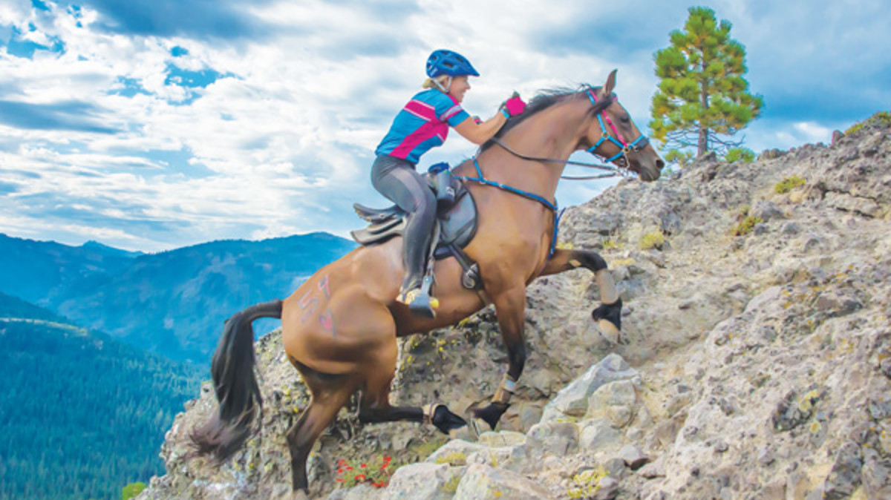

The HUMAN Equestrian Athlete
Hilary Gooding sports physiotherapist

Slide 2
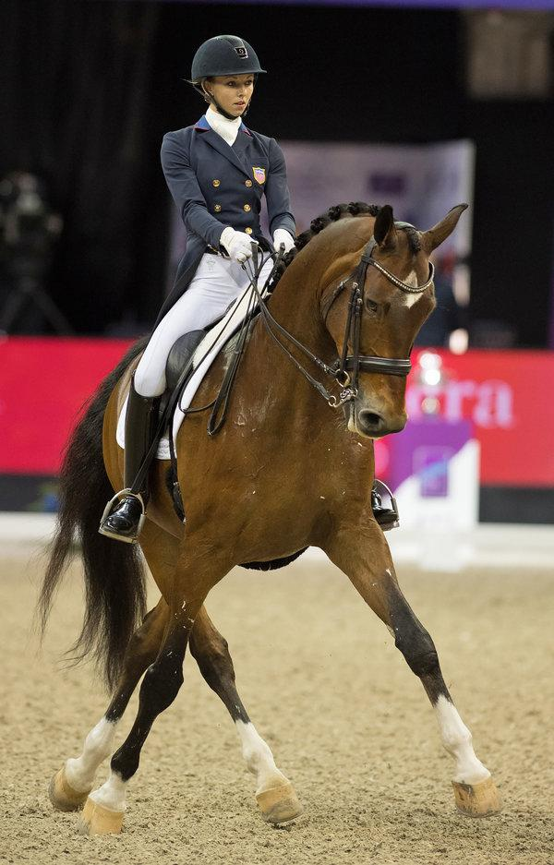
Overview
Riders aids
Physical requirements of the rider
Common injuries
Rehabilitation from injury
Exercises to improve your riding

Slide 3
Riders Natural Aids
Leg (Lower)
  Most control over horses hindquarters and shoulder
  Main aid along with seat
  Even bilateral pressure = ↑ speed, or rein back
  Unilateral pressure = assists ipsilateral cornering or contralateral movement
  Hip external rotation→ankle eversion→plantar flexion
  Hands
    Guides horses head and neck
    Overused with inexperienced riders
    Can be used to block/contain forward energy
    Direct rein / Indirect rein
    Steady hands that act independently from body
  Seat
    Pelvis/thigh contact with saddle
    Half halt
    Shifting CoG in the sagittal plane can change the horses speed
    Unilateral WB = ipsilateral corner
  Voice
  Depends on the horse
  Change speed
  Praise
  Calming a nervous horse
Excessive use of an aid will desensitize the command to the horse

Slide 4
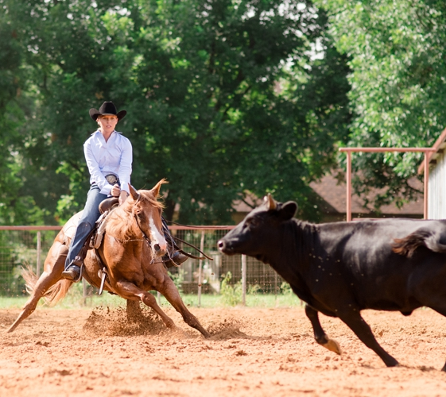
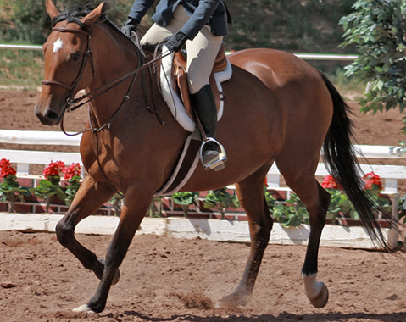
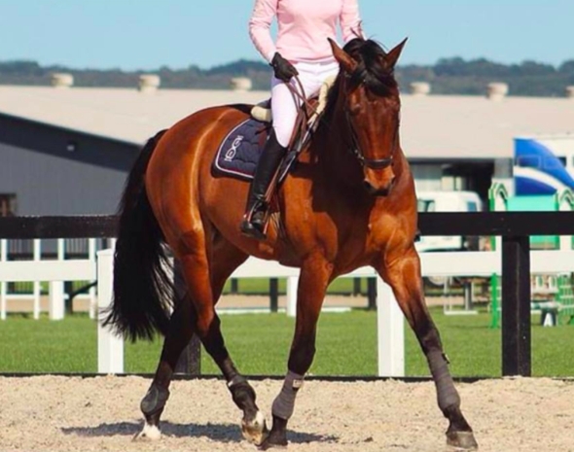
PASSIVE OR ACTIVE RIDER
- Dropped inside shoulder, not tracking through
- Ineffective inside lower leg aid
- Shoulders level
- Effective inside lower leg aid

Slide 5
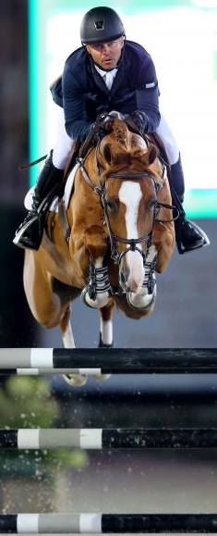
Requirements for THE EQUESTRIAN ATHLETE
Consensus that riders require physical fitness for balance and effectiveness (Alfredson et al., 1998; Douglas et al., 2012; Meyers, 2006; Meyers and Sterling, 2000; Roberts et al., 2010; Westerling, 1983).
Range of movement
  Ankle dorsiflexion, hip flexion, neck extension (Kang et al 2010; Nankervis et al 2015)
Muscular
  Isometric contraction
  Stabilisation
  Symmetry for strength and endurance (Terada et al. 2004)
Cardiovascular
    Heart rate = hard to very hard demand (Douglas 2017)
Functional
  Squat, drop jump, shock absorption, grip, balance and co-ordination (Williams & Tabor 2017; Engell et al 2016)

Slide 6
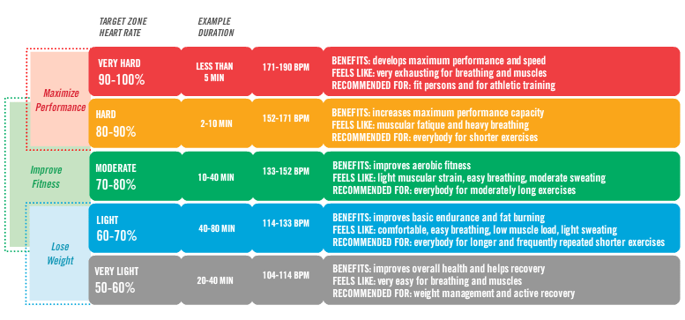
Hear rate zones

Slide 7
 | Physiological Demand | Suggested Cardiovascular Training Method | Suggested Muscular Training Method
Dressage | Moderate to hard heart rate demand Limited blood lactate concentration Predominantly aerobic, sustained over 5mins Upright trunk position Muscle activation for positional stabilization Limited ROM at joints | Aerobic exercise | Low intensity isometric holds at thigh and trunk musculature
Show Jumping | Hard to very hard heart rate demand Blood lactate close to threshold levels sustains for 2.5mins Large amount of hip and shoulder mobility Muscle activation for stabilization Low amplitude thigh and trunk contraction over jumps High amplitude thigh and trunk contraction between jumps | Intermittent aerobic exercise at high intensity above anaerobic threshold and low intensity below anaerobic threshold | Iso-ballistic exercises Oscillatory isometric exercises Quasi isometric movements
Cross Country | Very hard heart rate intensities Blood lactate close to or above anaerobic threshold High amplitude thigh and trunk muscle contraction for longer periods between jumps | Cardiovascular exercise at anaerobic threshold - Aerobic exercise between resistance training | Same muscular training as suggested in Show Jumping but with longer durations
Douglas (2017)

Slide 8
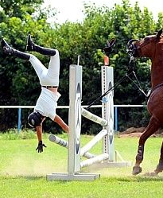
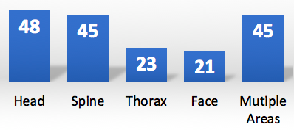
Common injuries
Acute Injuries
Novice riders have 8 times greater risk of injury compared to professional riders
Concussion, fractures, hemothorax, lacerations and bruising
Cause: Fall 73% + crushed 39%
Overuse injuries
Lower back, shoulder and lower extremity
Common Injury Site
%
Carmichael 2014; Mayberry et al., 2007; Zuckerman et al 2015; Pugh 2004

Slide 9

Rehabilitation phases
Phase 1
Recover with optimal loading
Not just rest
Phase 2
Muscular endurance, symmetry and Neuromuscular control
Regain mobility
Phase 3
Running, Agility, and Landing
Safe dismount
Safe 2-point position
Phase 4
Complete return to Equestrian Sports

Slide 10
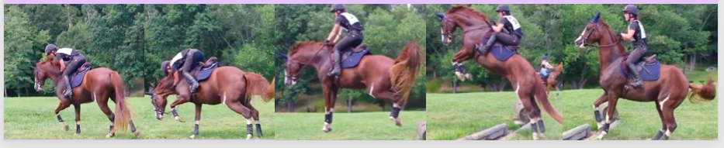
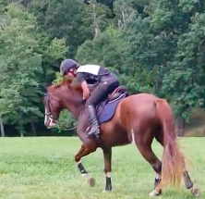
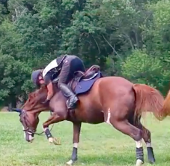
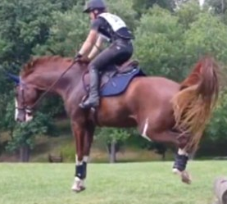
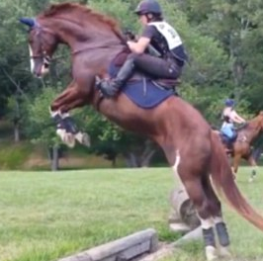
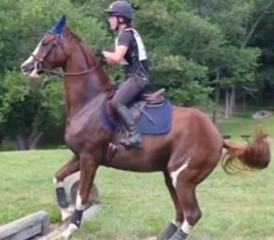
Phase 5 injury Prevention (ACUTE)
Don’t fall
Maintain muscular endurance, symmetry, and balance
Gym/Pilates Program
Proprioceptive/Neuromuscular Training (Verhagen et al., 2004)
If you do fall
Learn how: tuck and roll falling technique
Protective gear
Learn from it

Slide 11
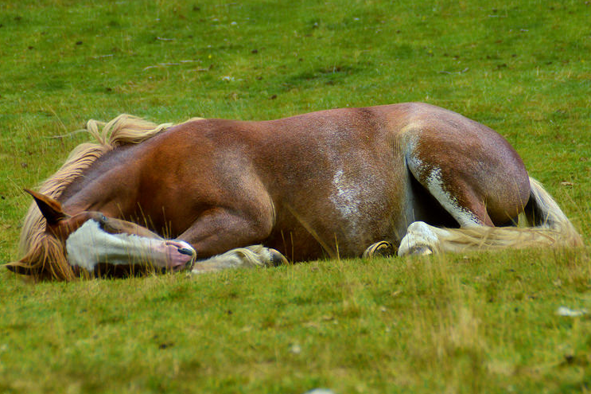
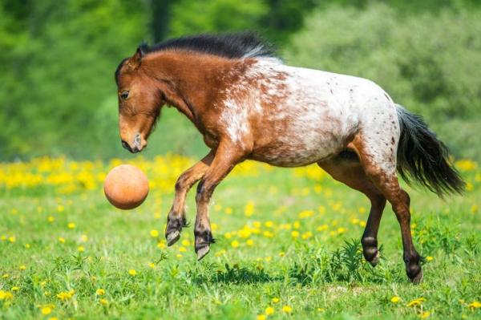
Phase 5 injury Prevention (CHRONIC)
LOWER BACK
Lumbopelvic mobility
Lumbopelvic control
Core over/under activation
Avoid lifting awkwardly
SHOULDER
Scapular position
Scapular stability
Upper limb and back strength
Upper limb and back endurance
LOWER EXTREMITY
Muscular symmetry
Lower limb strength
Lower limb endurance
Balance
IMPROVE TISSUE TOLERANCE
Good sleep quantity and quality
Minimise stress
Load management

Slide 12
EXERCISE TIME!

Slide 13
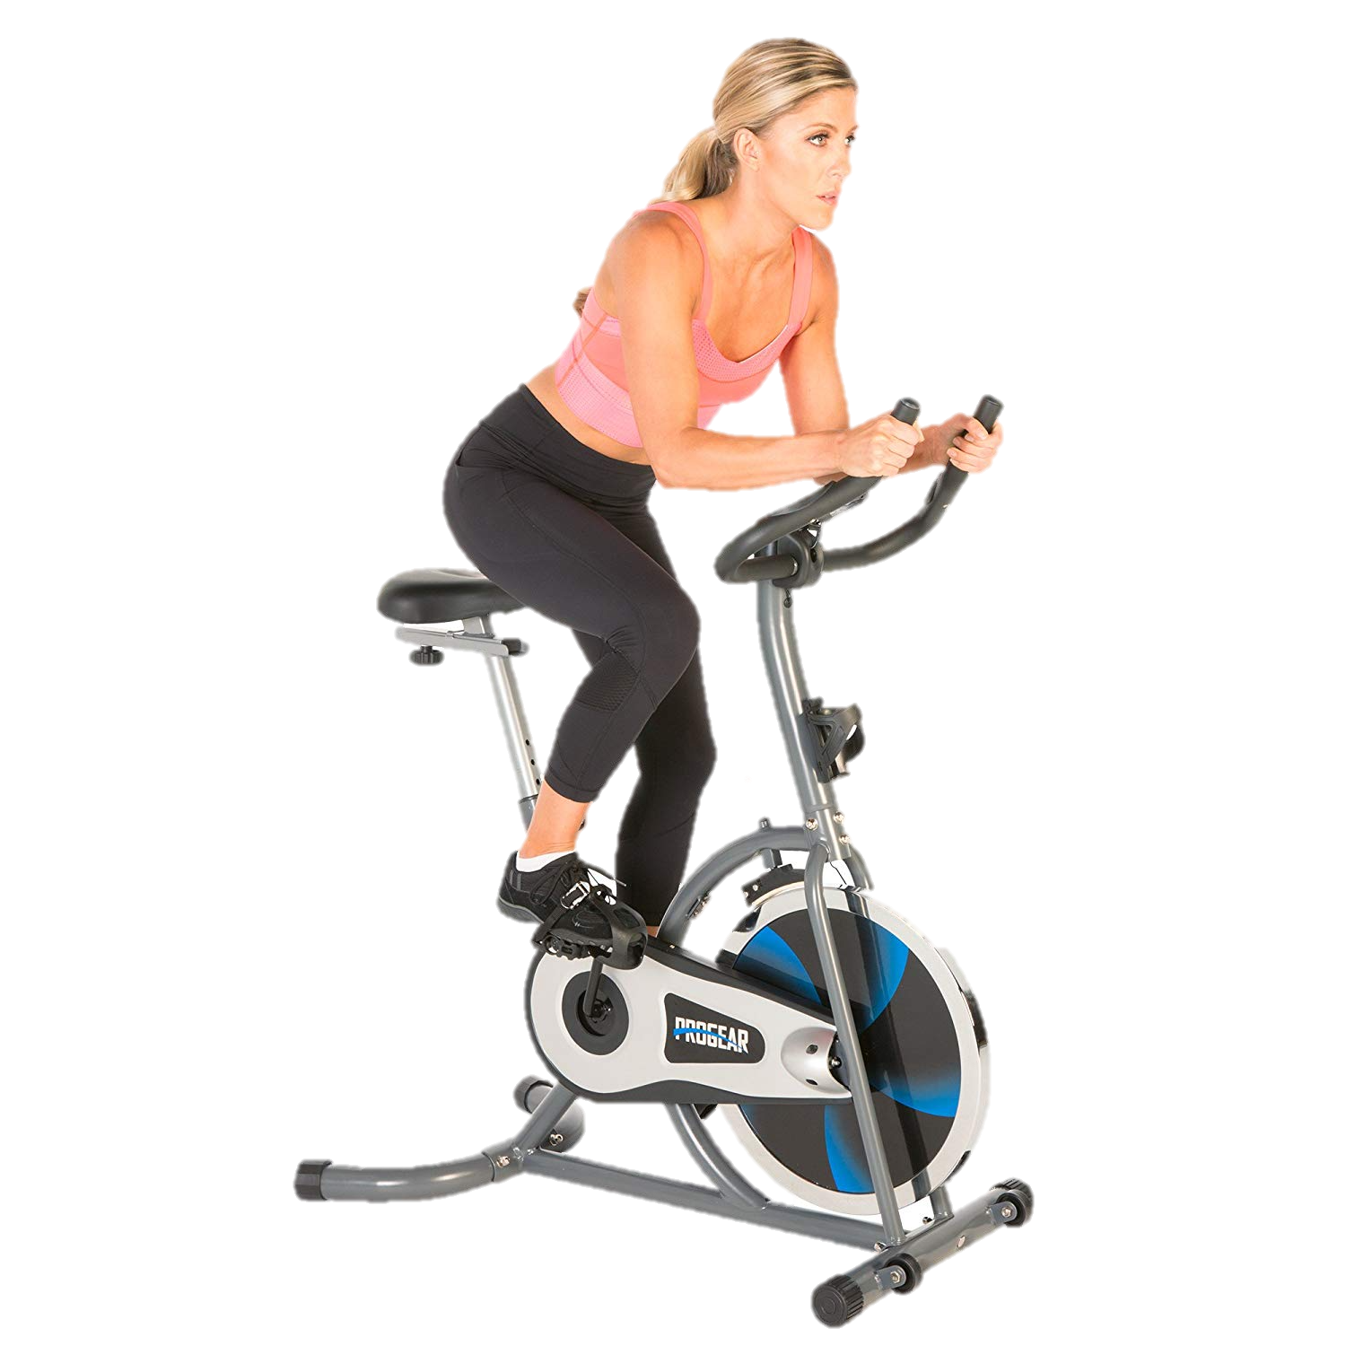
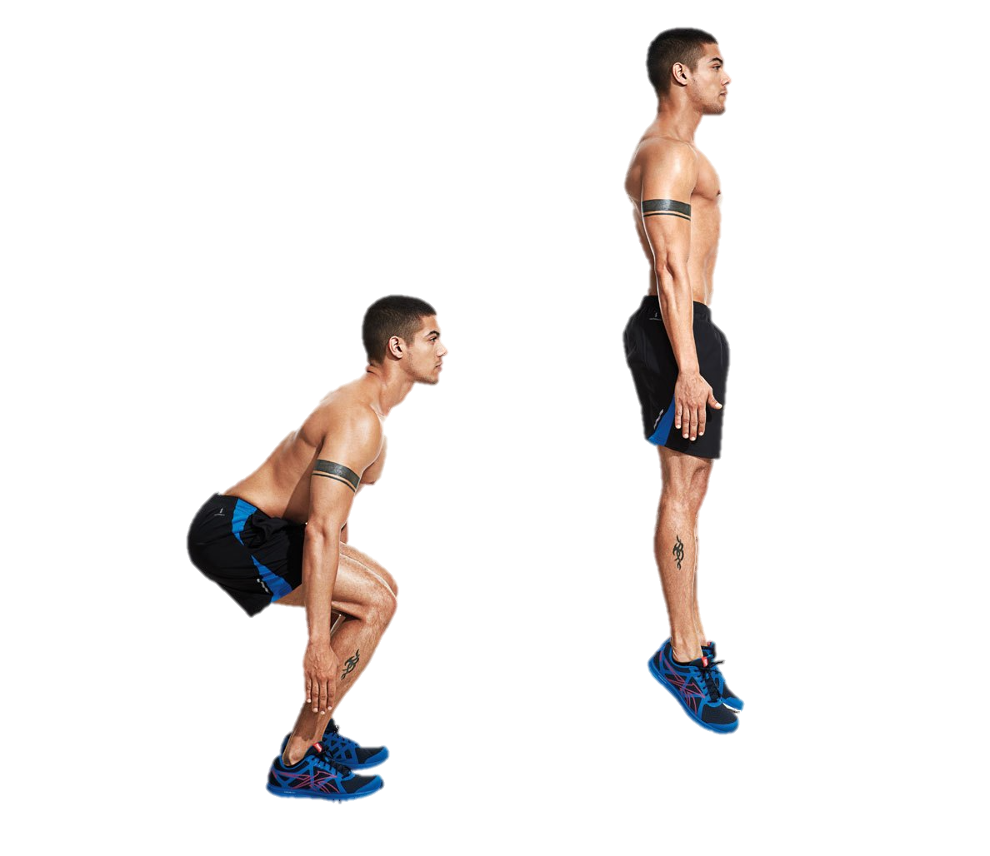
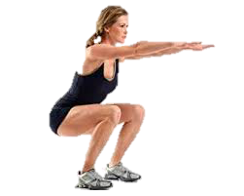
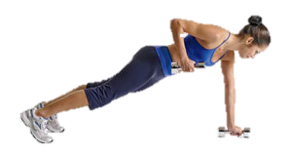
Suggested Training methods
Intermittent aerobic exercise at above and below anaerobic threshold (Douglas 2017)
Iso-ballistic exercises (Thibaudeau, 2006)
Oscillatory isometric exercises (Millar et al. 2014)
Quasi isometric movements (Vogiatzis 2011)

Slide 14
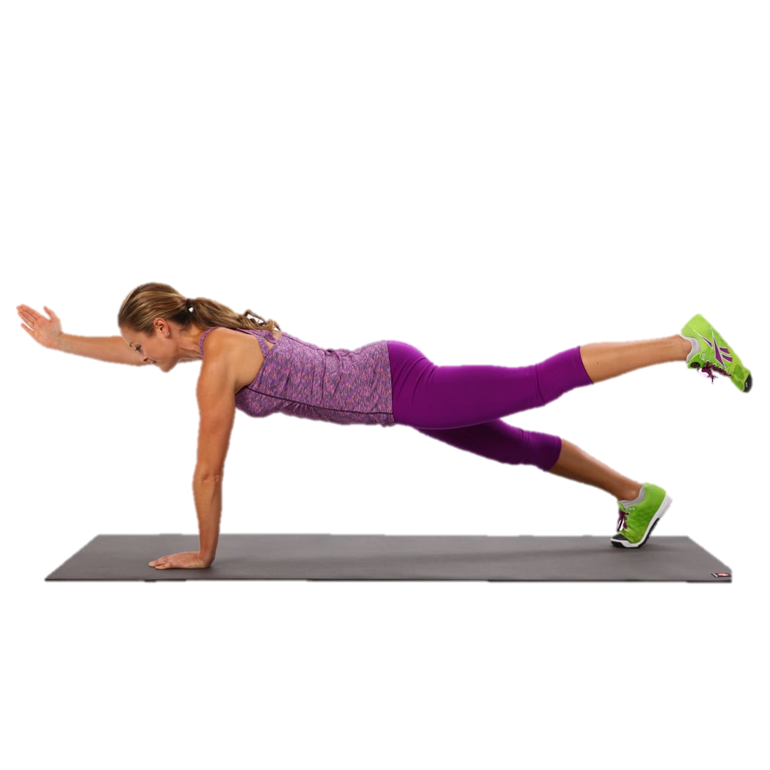
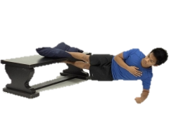
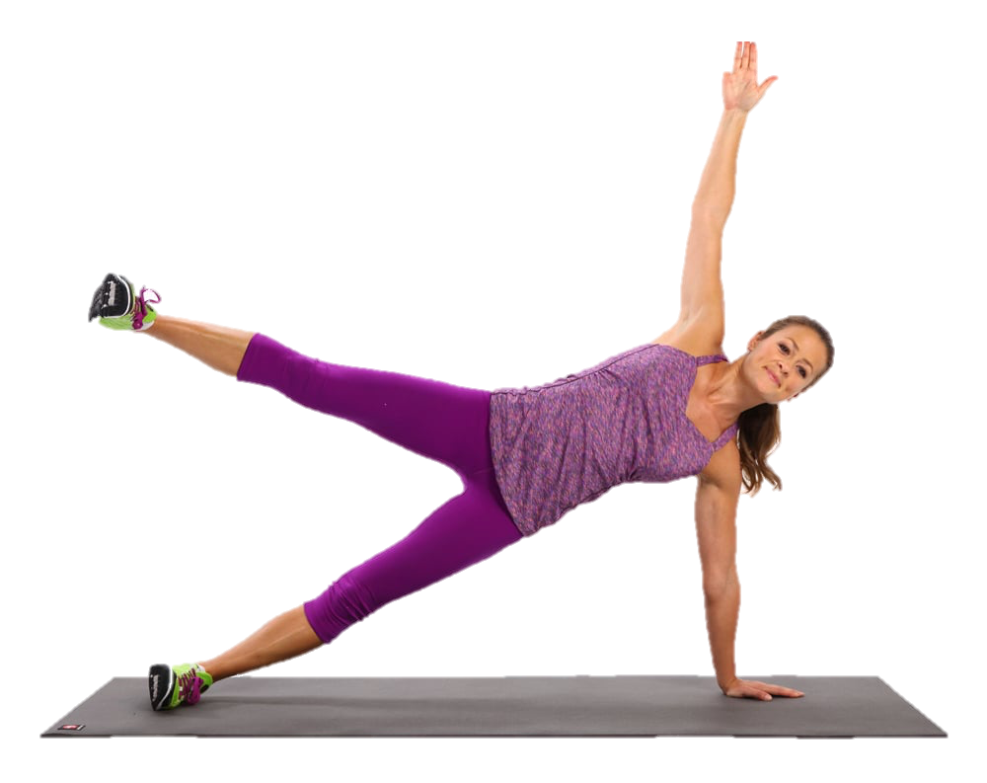
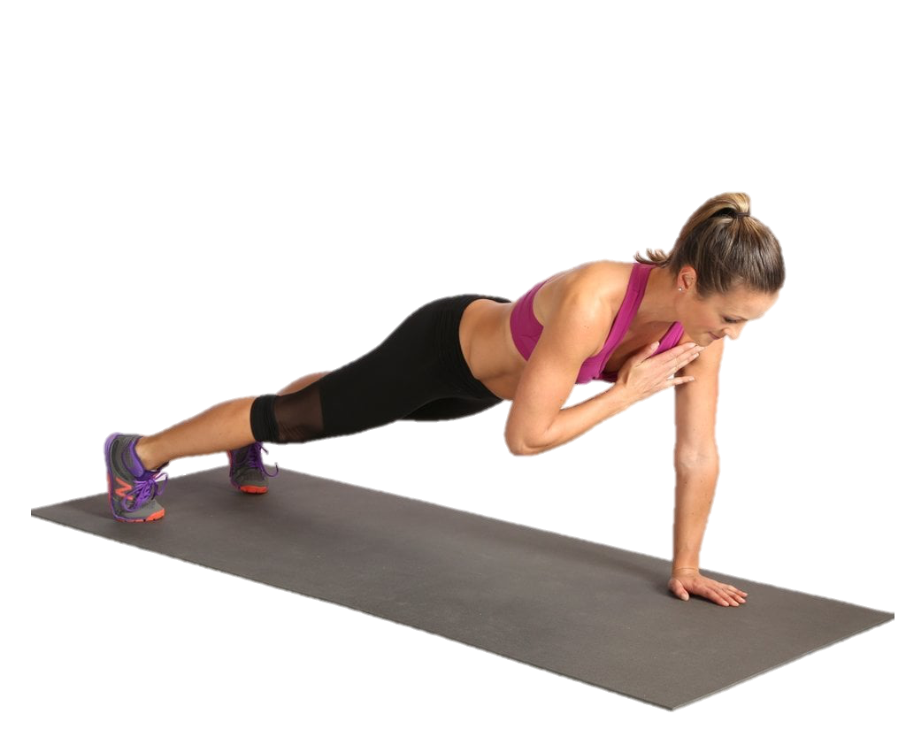
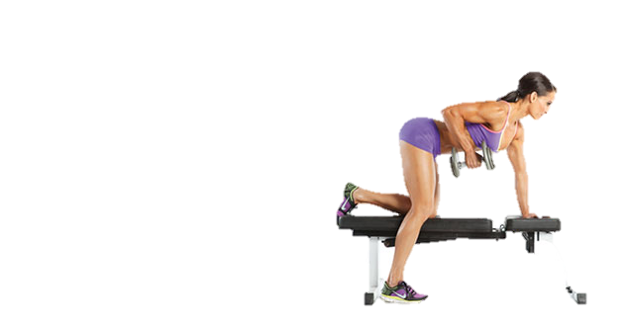
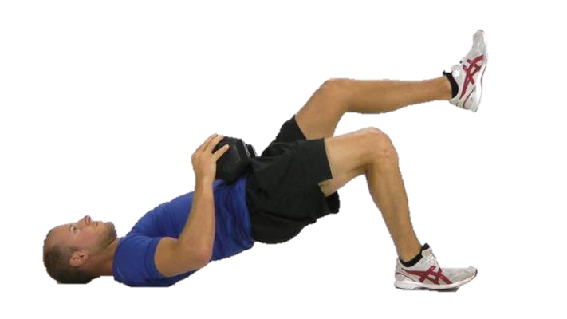
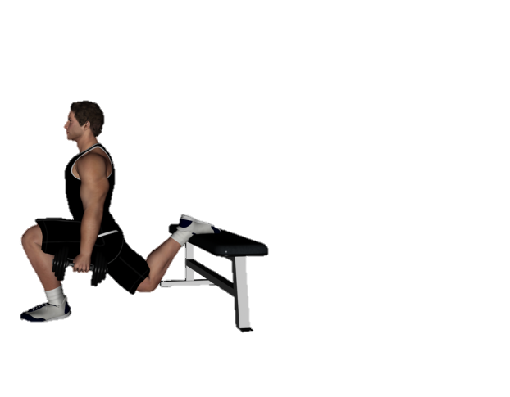
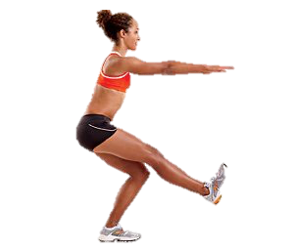
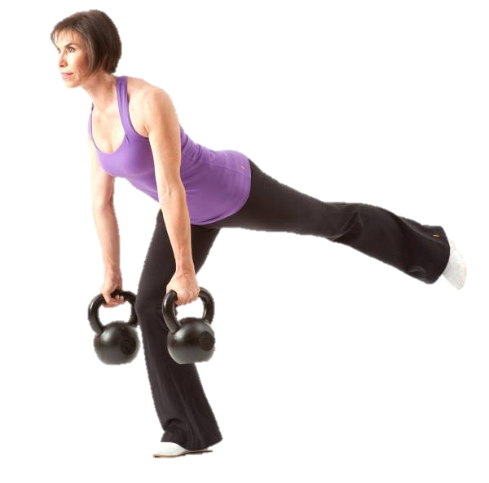
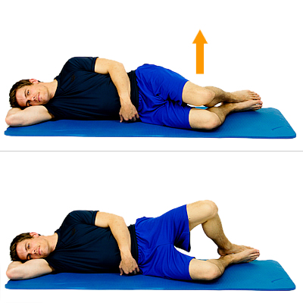
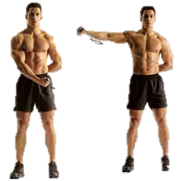
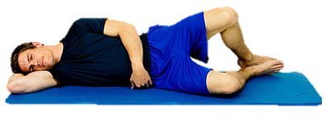
Exercises to improve symmetry

Slide 15
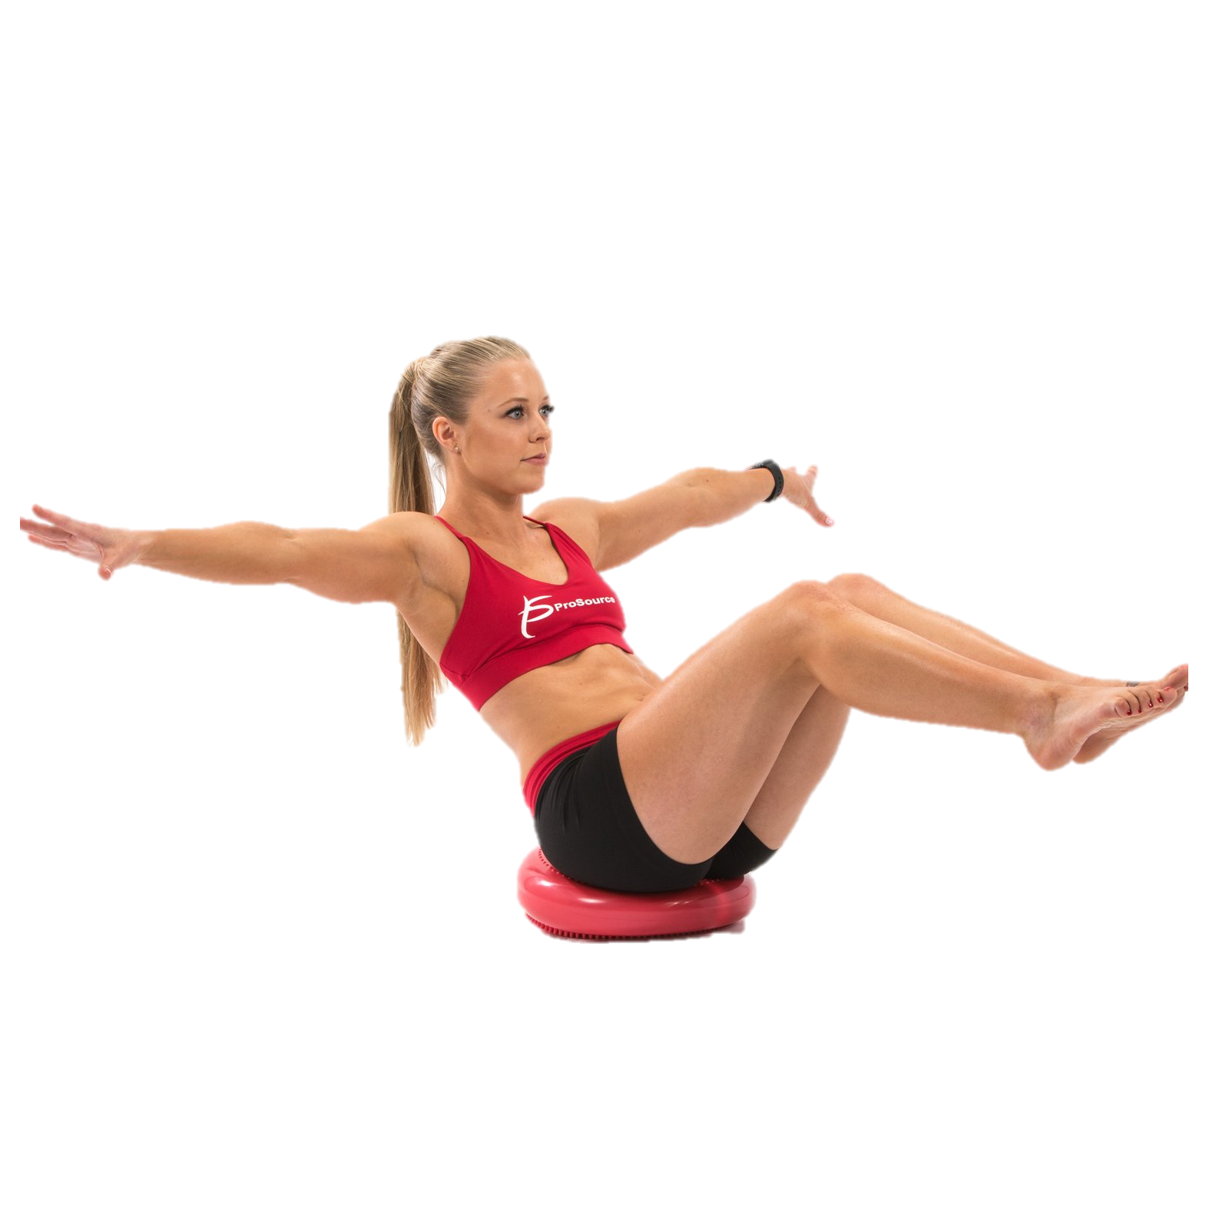
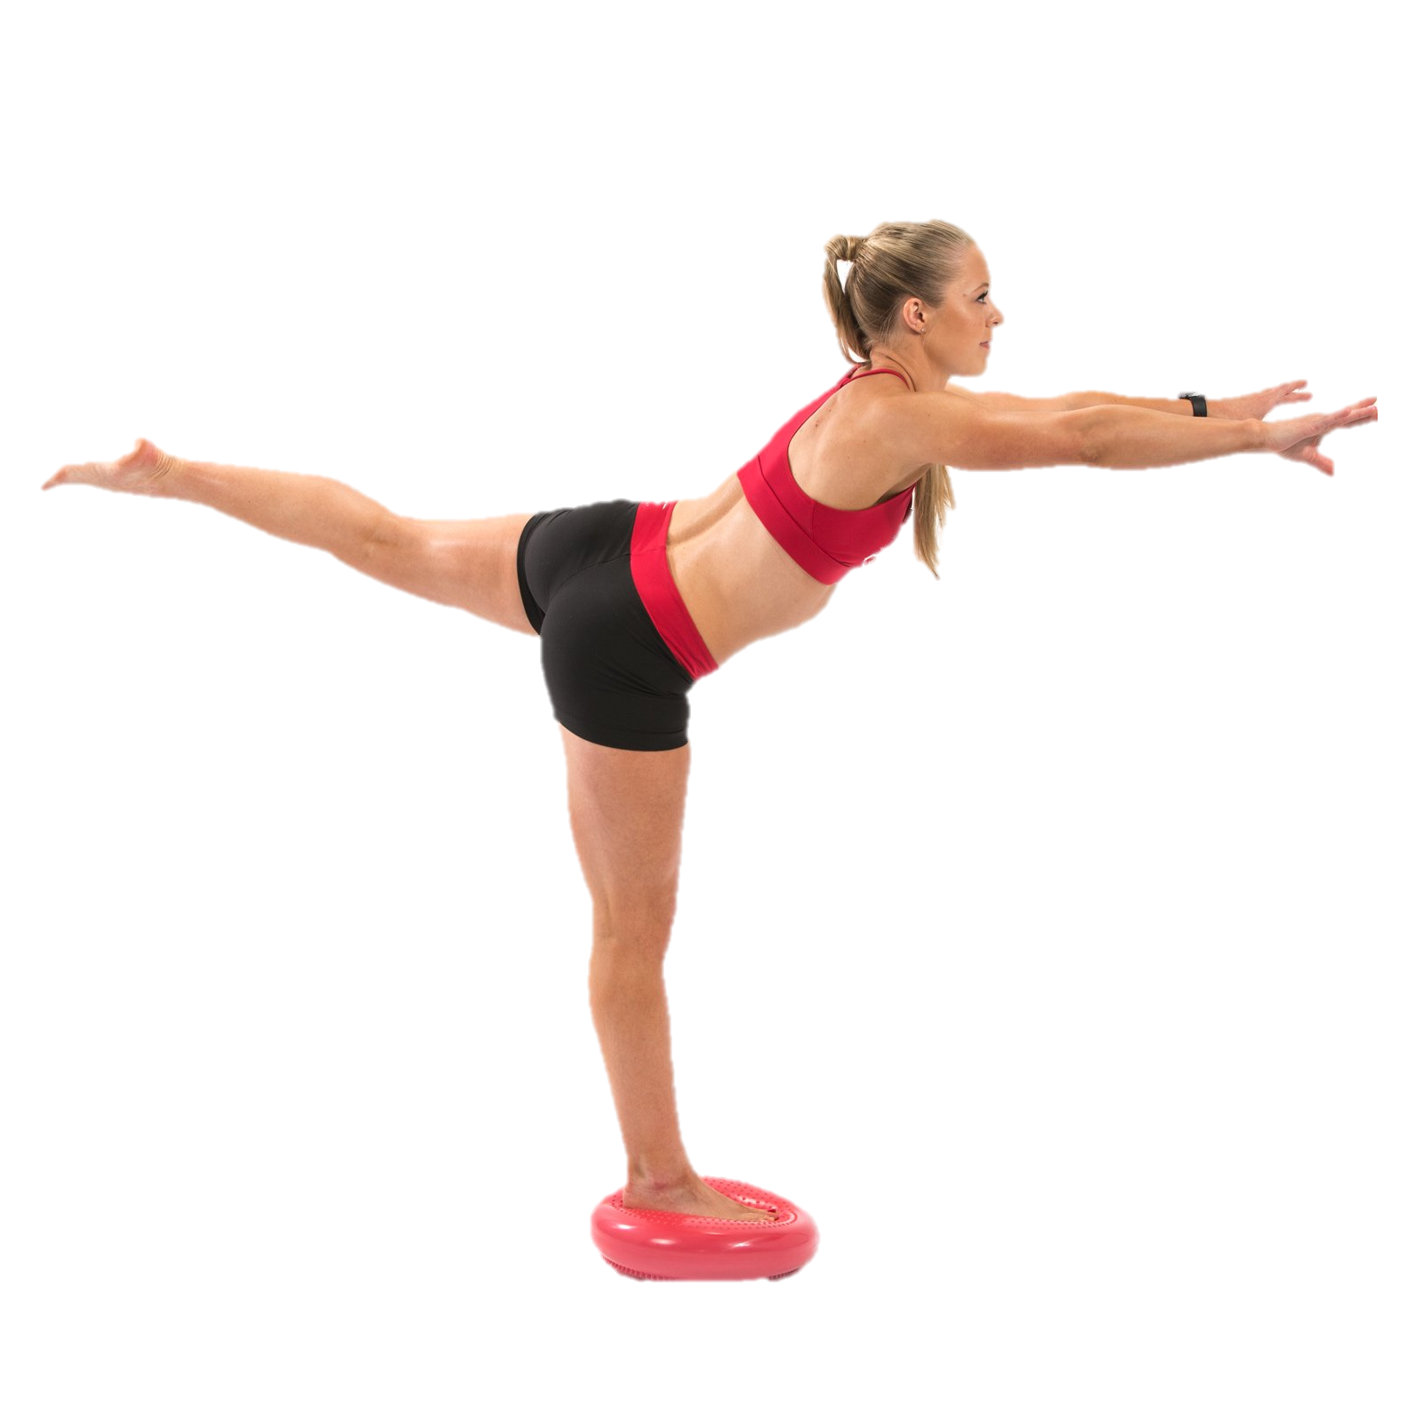
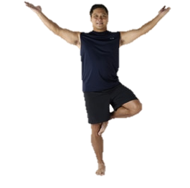
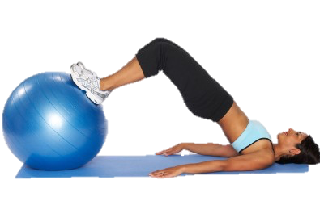
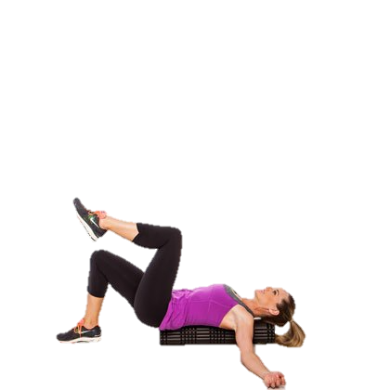
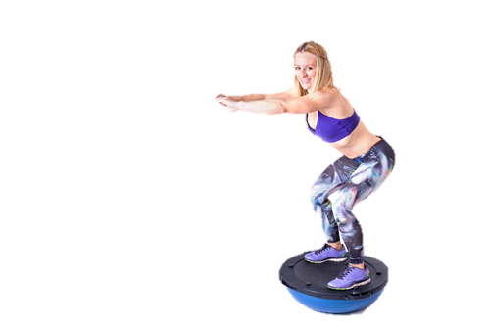
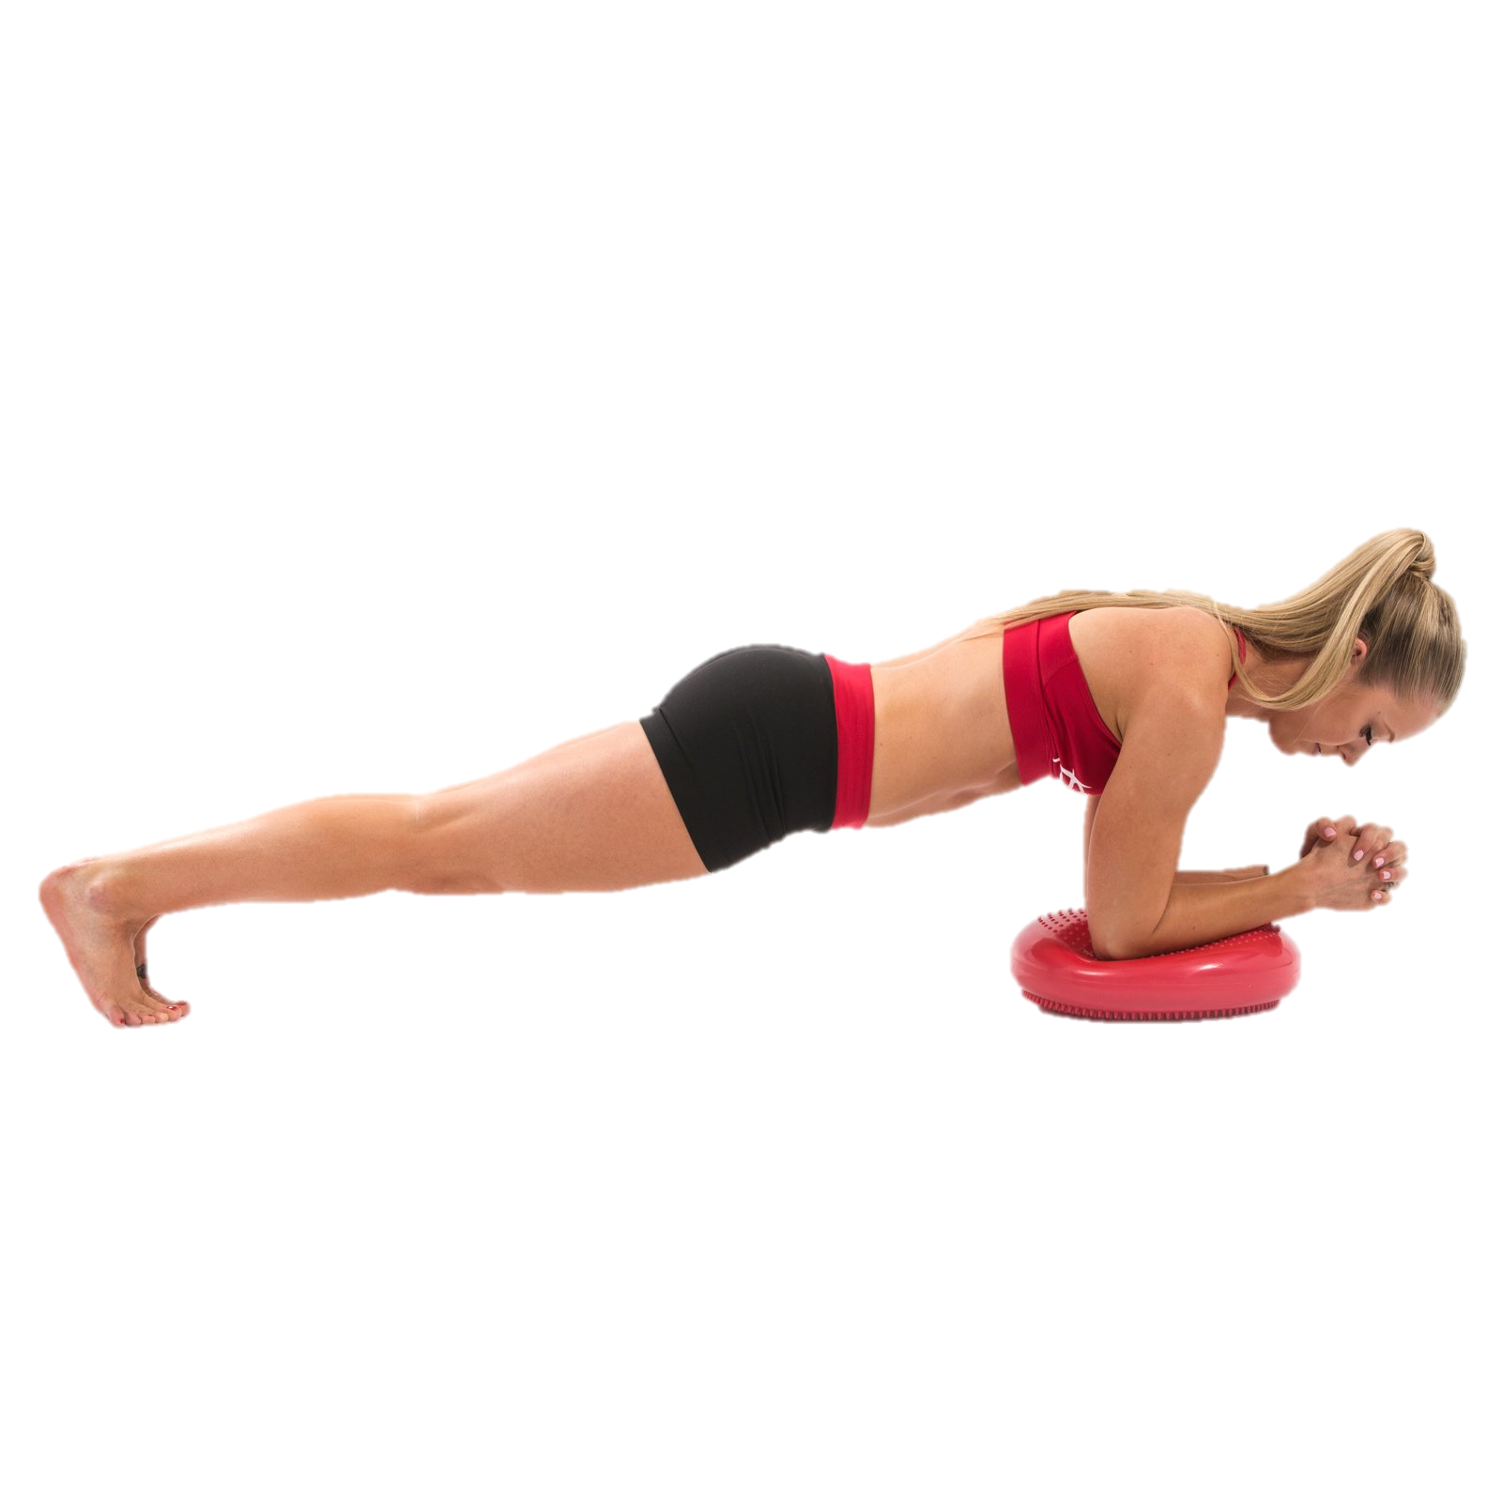
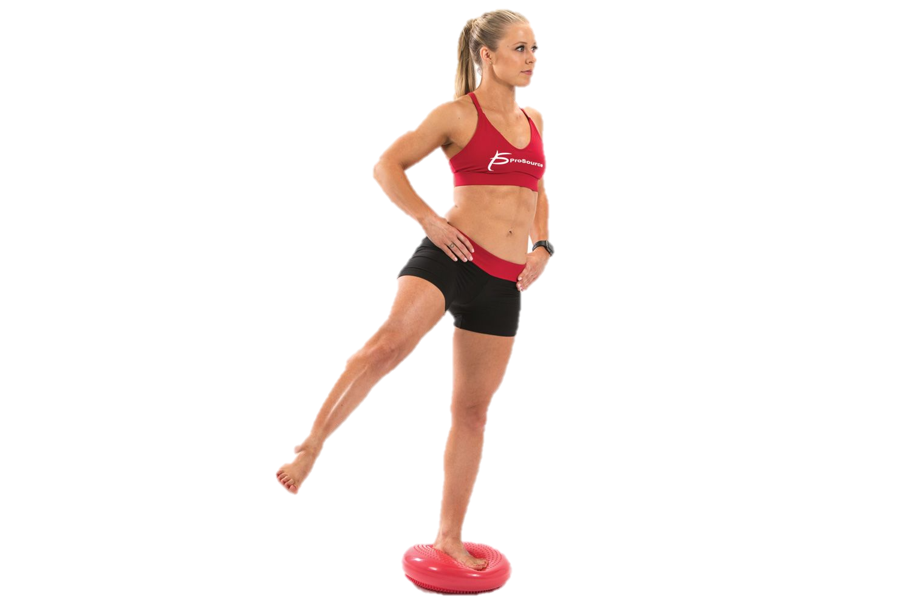
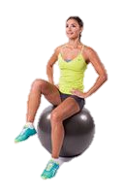
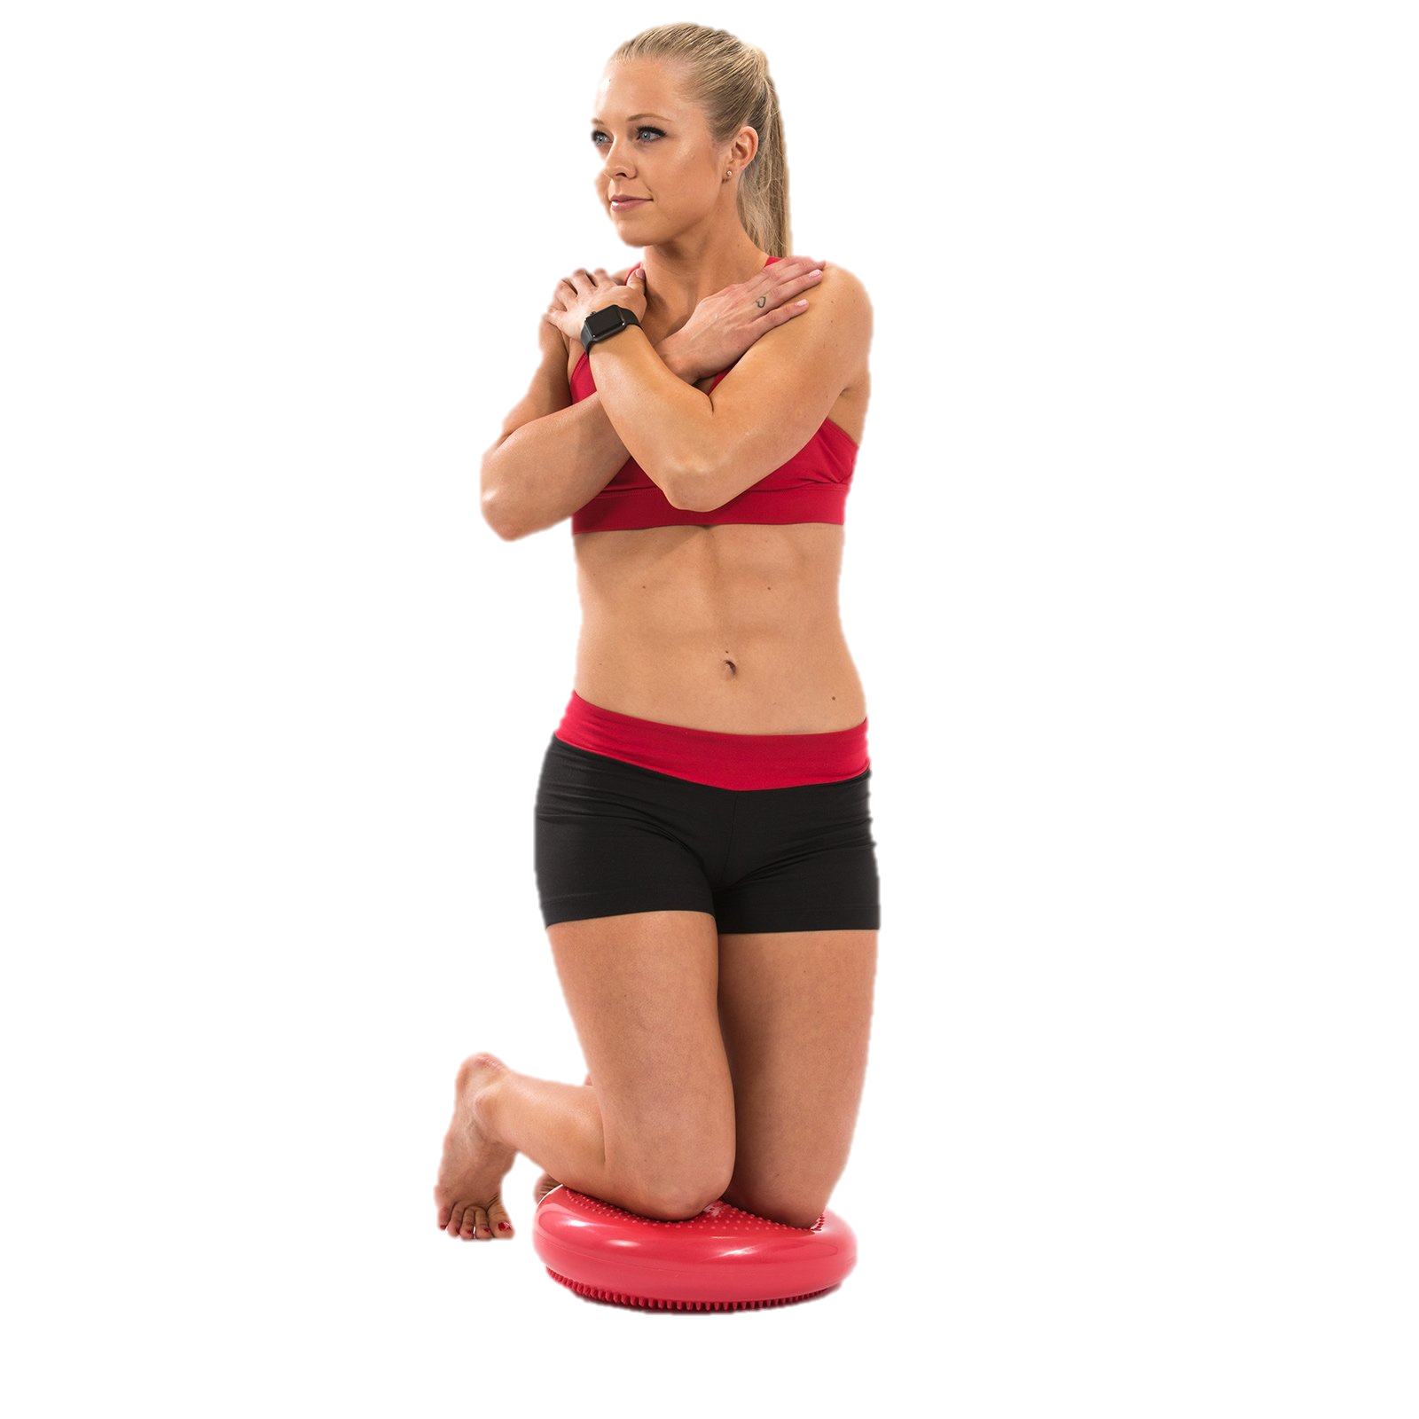
Exercises to improve Balance

Slide 16
Questions?

Slide 17
references
Alfredson H, Hedburg, G., Bergstom, E., Nordstrom, P., Lorentzon, R. High Thigh Strength but Not Bone Mass in Young Horseback Riding Females. Calcified Tissue International. 1998;62:497-501.
Bleakley CM, Glasgow, P., MacAuley, D.C. . PRICE needs updating, should we call the POLICE? . Br J Sports Med. 2012;46(4):220-1.
Boldin C, Grechenig W, Mayr J, Szyszkowitz R. Die operative Behandlung der Maisonneuve-Verletzung. Operative Orthopädie und Traumatologie. 2004;16(4):433-50.
Carmichael SP, 2nd, Davenport DL, Kearney PA, Bernard AC. On and off the horse: mechanisms and patterns of injury in mounted and unmounted equestrians. Injury. 2014;45(9):1479-83.
Clayton HM. Terminology for the Description of Equine Jumping Kinematics. Journal of Equine Veterinary Science. 1989;9(6):341-8.
Clayton HM. Time-Motion Analysis of Show Jumping Competitions. Journal of Equine Veterinary Science. 1996;16(6):262-6.
Clayton HM, Hobbs, S.J. The role of biomechanical analysis of horse and rider in equitationscience. Applied Animal Behaviour Science. 2017;190(2017):123-32.
de Godoi FN, Toral FLB, de Miranda ALS, Menzel H-JK, de Almeida FQ, Bergmann JAG. Kinematic and morphological traits and the probability of successful jumps of young Brazilian Sport Horses. Livestock Science. 2016;185:8-16.
Douglas J. Physiological Demands of Eventing and Performance Related Fitness in Female Horse Riders. PhD thesis: University of Worcester; 2017.
Douglas J, Price, M., Peters, D.M. A systematic review of physiological fitness and biomechanical performance in equestrian athletes. Comparative Exercise Physiology. 2012;8(3):53-62.
Engell M, Clayton, H., Egenval, A., Weishaupt, M., & Roepstorff, L. Postural changes and their effects in elite riders when actively influencing the horse versus sitting passively at trot. Comparative Exercise Physiology. 2016;12(1):27-33.
Hoch MC, McKeon PO. Normative range of weight-bearing lunge test performance asymmetry in healthy adults. Man Ther. 2011;16(5):516-9.
Jelinek JA, Porter, D.A. Management of unstable ankle fractures and syndesmosis injuries in athletes. . Foot Ankle Clin 2009;14(277-98).
Kang OD, Ryu YC, Ryew CC, Oh WY, Lee CE, Kang MS. Comparative analyses of rider position according to skill levels during walk and trot in Jeju horse. Human movement science. 2010;29(6):956-63.
Latham A, Goodwin, P., Stirling, B. & Budgen, A. Ankle Syndesmosis Repair and Rehabilitation in Professional Rugby League Players: A Case Series Report. BMJ Open Sport Exerc Med. 2017;3:1-6.
Mayberry JC, Pearson TE, Wiger KJ, Diggs BS, Mullins RJ. Equestrian injury prevention efforts need more attention to novice riders. The Journal of trauma. 2007;62(3):735-9.
Meyers M. Effect of Equitation Training on Health and Physical Fitness of College Females. . European Journal of Applied Physiology. 2006;98:177.
Meyers MC, and Sterling, J.C. Physical, Hematological, and Exercise Response of Collegiate Female Equestrian Athletes. Journal of Sports Medicine and Physical Fitness. 2000;40:131-8.
Millar P, McGowan, C., Cornelissen, V., Arajo, C., Swaine, I. Evidence for the role of isometric exercise training in reducing blood pressure: potential mechanisms and future directions. Sports Medicine. 2014;44(3):345-56.
Moriguchi C, Sato T, Gil Coury H. Ankle movements during normal gait evaluated by flexible electrogoniometer. Brazilian Journal of Physical Therapy. 2007;11:205-11.
Mulligan EP. Evaluation and management of ankle syndesmosis injuries. Physical Therapy in Sport. 2011;12(2):57-69.
Nankervis K, Dumbell, L., Herbert, L., Winfield, J., Guire, R., Launder, E. A comparison of the position of elite and non-elite riders during competitive show jumping. Comparative Exercise Physiology. 2015;11(2):119-25.
Nemecek P, Cabell, L., Janura, M. Horse and Rider Interaction During Simulated Horse Jumping. Journal of Equine Veterinary Science. 2018;70(2018):26-31.
Pfau T, Spence, A., Starke, S., Ferrari, M., Wilson, A. Modern riding styleimproves horse racing times. Science. 2009;325:289.
Powden CJ, Hoch JM, Hoch MC. Reliability and minimal detectable change of the weight-bearing lunge test: A systematic review. Manual Therapy. 2015;20(4):524-32.
Protopapadaki A, Drechsler WI, Cramp MC, Coutts FJ, Scott OM. Hip, knee, ankle kinematics and kinetics during stair ascent and descent in healthy young individuals. Clinical biomechanics (Bristol, Avon). 2007;22(2):203-10.
Pugh TB, D. Overuse injuries in equestrain athletes. Curr Sports Med Rep Journal. 2004;3(6):297-303.
Roberts M, Shearman, J., Marlin, D. A comparison of the metabolic cost of the three phases of the one-day event in female collegiate riders. Comparative Exercise Physiology. 2010;6(3):129-35.
Rohner-Spengler M, Mannion, A., Babst, R. Reliability and Minimal Detectable Change for the Figure-of-Eight-20 Method of Measurement of Ankle Edema. Journal of Orthopaedic and Sports Physical Therapy. 2007;37(4):199-205.
Terada K, Millineaux, D., Lanovaz, J., Kato, K. and Clayton, H. Electromyographic Analysis of the Riders Muscles at Trot. Equine and Comparative Exercise Physiology. 2004;1(3):193-8.
Thibaudeau C. Theory and application of modern strength and power methods. 2006.
Verhagen E, van der Beek A, Twisk J, Bouter L, Bahr R, van Mechelen W. The Effect of a Proprioceptive Balance Board Training Program for the Prevention of Ankle Sprains: A Prospective Controlled Trial. The American Journal of Sports Medicine. 2004;32(6):1385-93.
Vicenzino B, Branjerdporn, M., Teys, P., Jordan, K. Initial Changes in Posterior Talar Glide and Dorsiflexion of the Ankle After Mobilization With Movement in Individuals with Recurrent Ankle Sprain. Journal of Orthopaedic & Sports Physical Therapy. 2006;36(7):464-71.
Vogiatzis I, Andrianopoulos V, Louvaris Z, Cherouveim E, Spetsioti S, Vasilopoulou M, et al. Quadriceps muscle blood flow and oxygen availability during repetitive bouts of isometric exercise in simulated sailing. Journal of Sports Sciences. 2011;29(10):1041-9.
Westerling D. A study of the physical demands of riding. European Journal of Applied Physiology. 1983;50(3):373-82.
Williams G, Allen, E. Rehabilitation of Syndesmotic (High) Ankle Sprains. Sports Health. 2010;2(6):460-70.
Williams J, & Tabor, G. Rider impacts on equitation. Applied Animal Behaviour Science. 2017;190(May):28-42.
Zuckerman SL, Morgan CD, Burks S, Forbes JA, Chambless LB, Solomon GS, et al. Functional and Structural Traumatic Brain Injury in Equestrian Sports: A Review of the Literature. World neurosurgery. 2015;83(6):1098-113.

