Slide 1
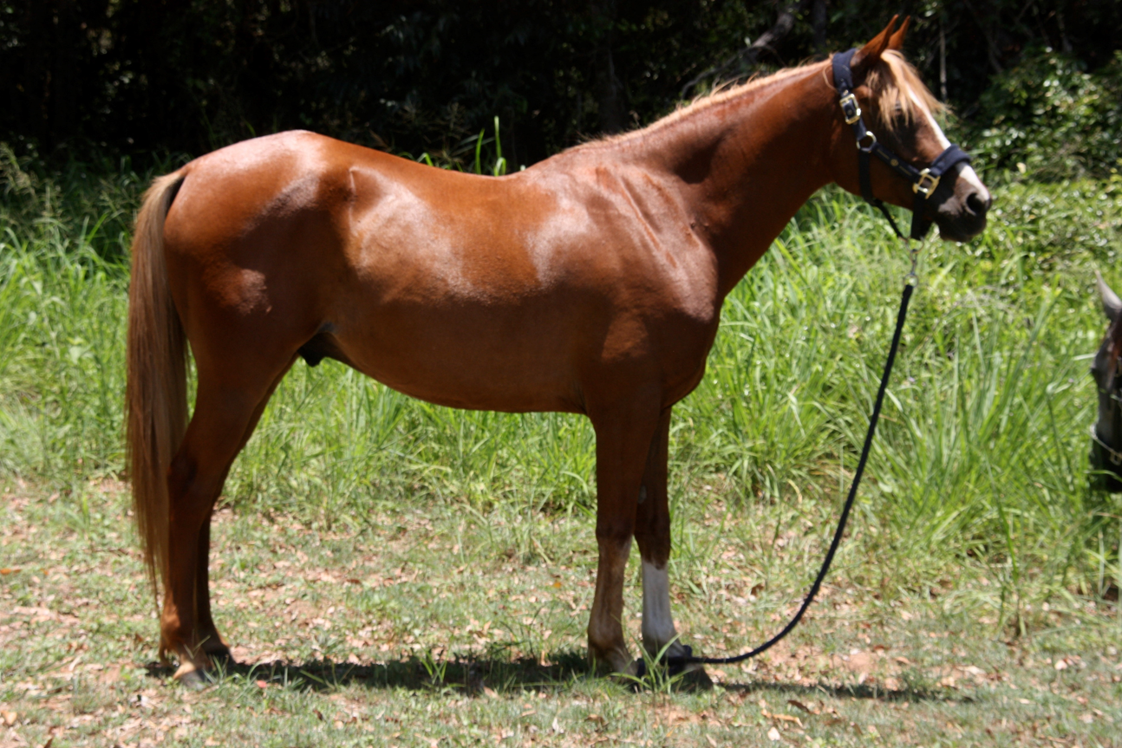
Feeding for performance - Naturally
Virginia Dale

Slide 2
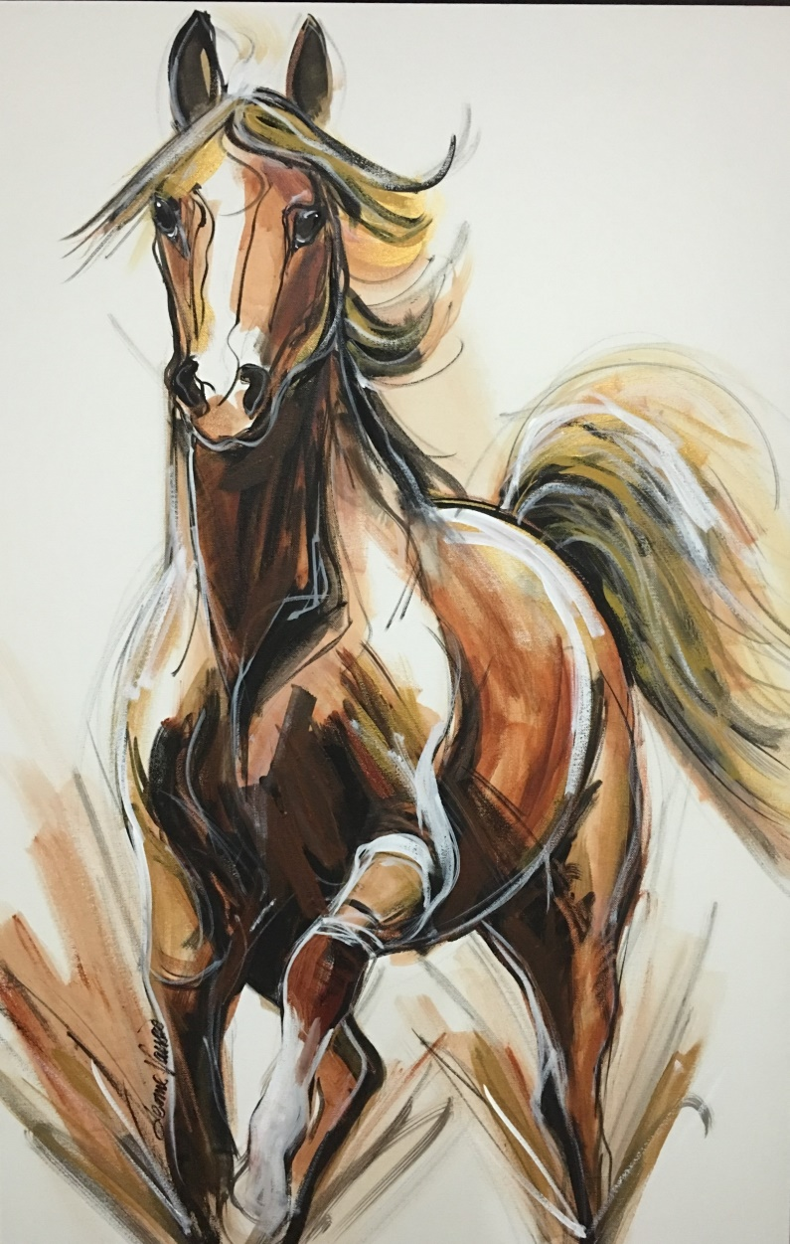

Jum Jum Spirit
January 2014 – our first season

Slide 3
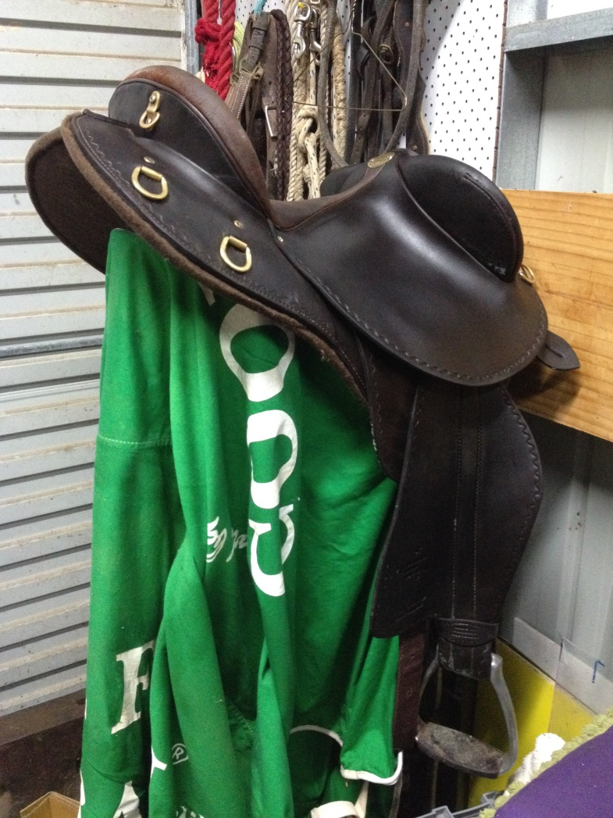
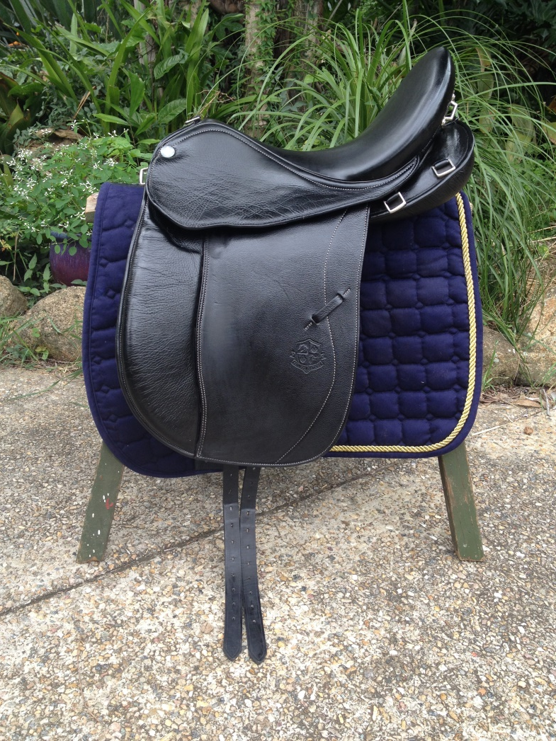
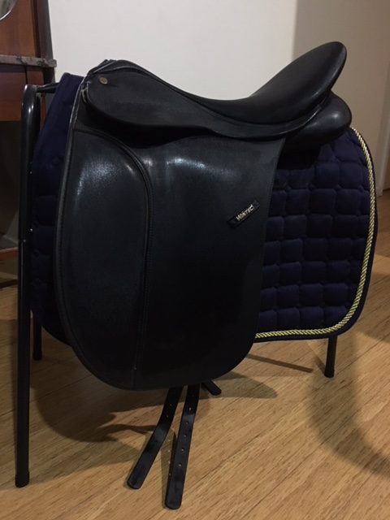
First saddle
Third saddle
Fourth saddle

Slide 4
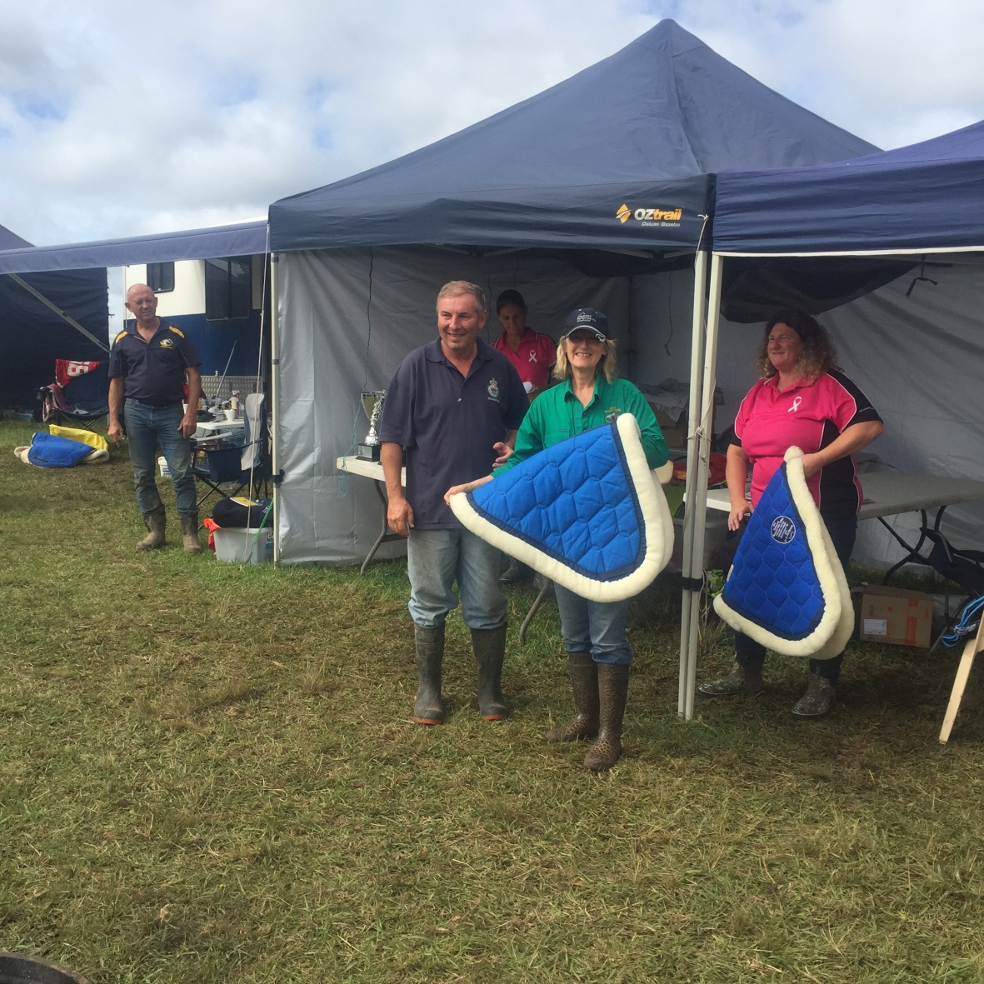
Homewood 160km
Equal first
Best Conditioned

Slide 5
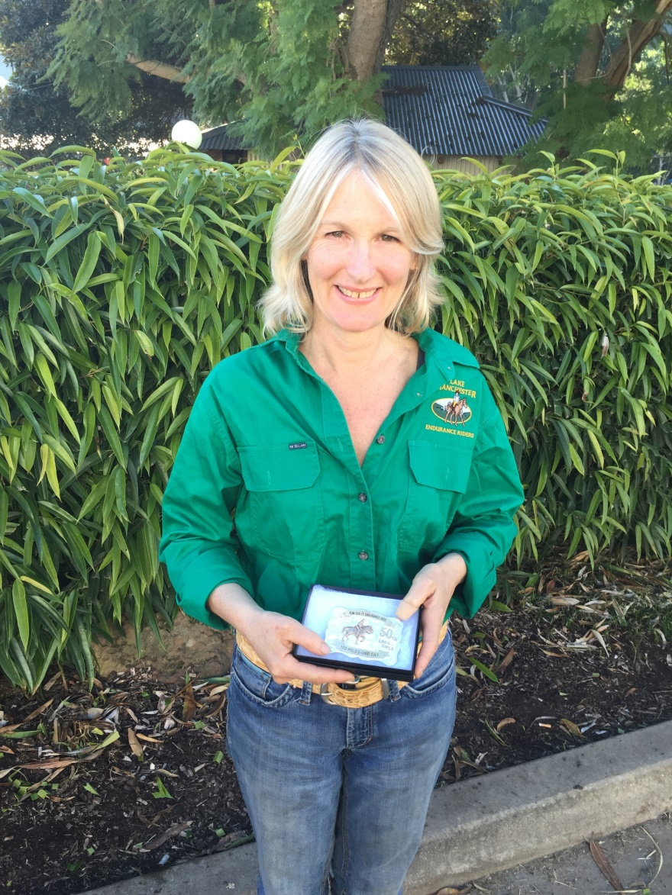
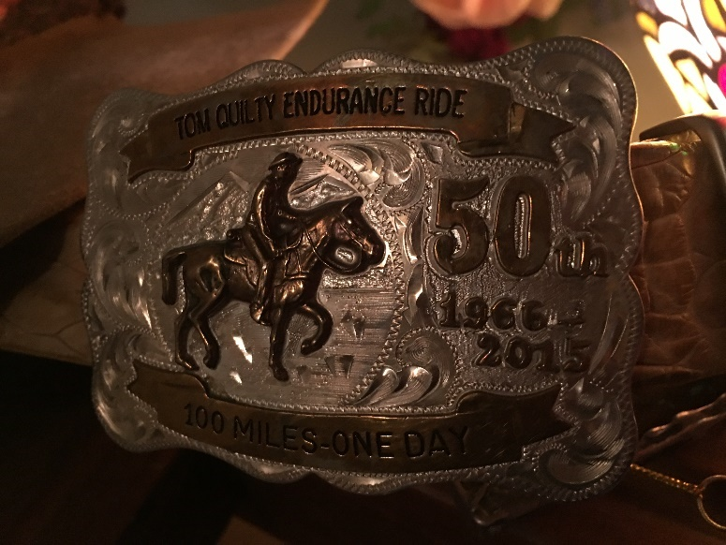
Tom Quilty Buckle 2015

Slide 6
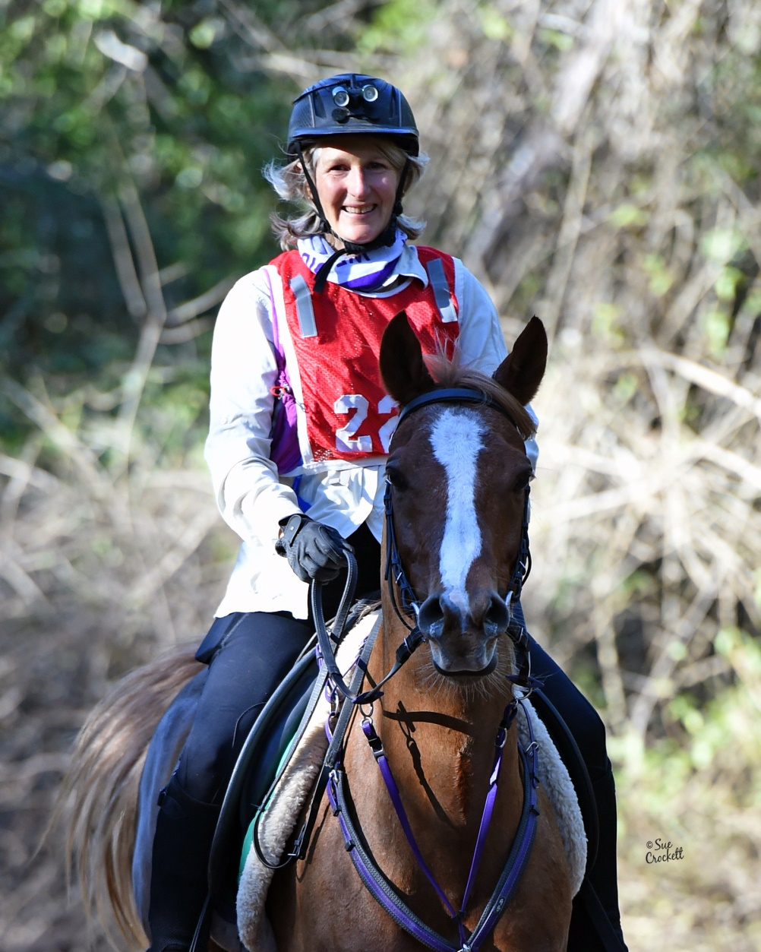
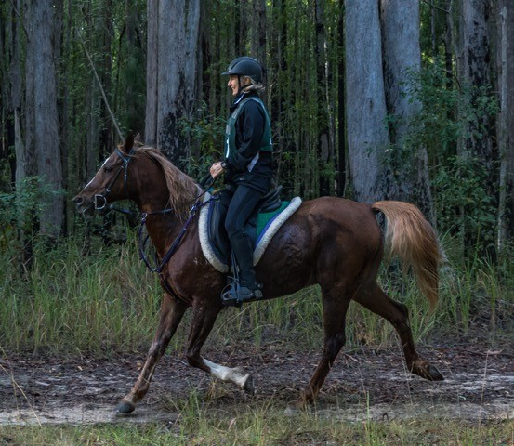
There is nowhere that we would rather be

Slide 7
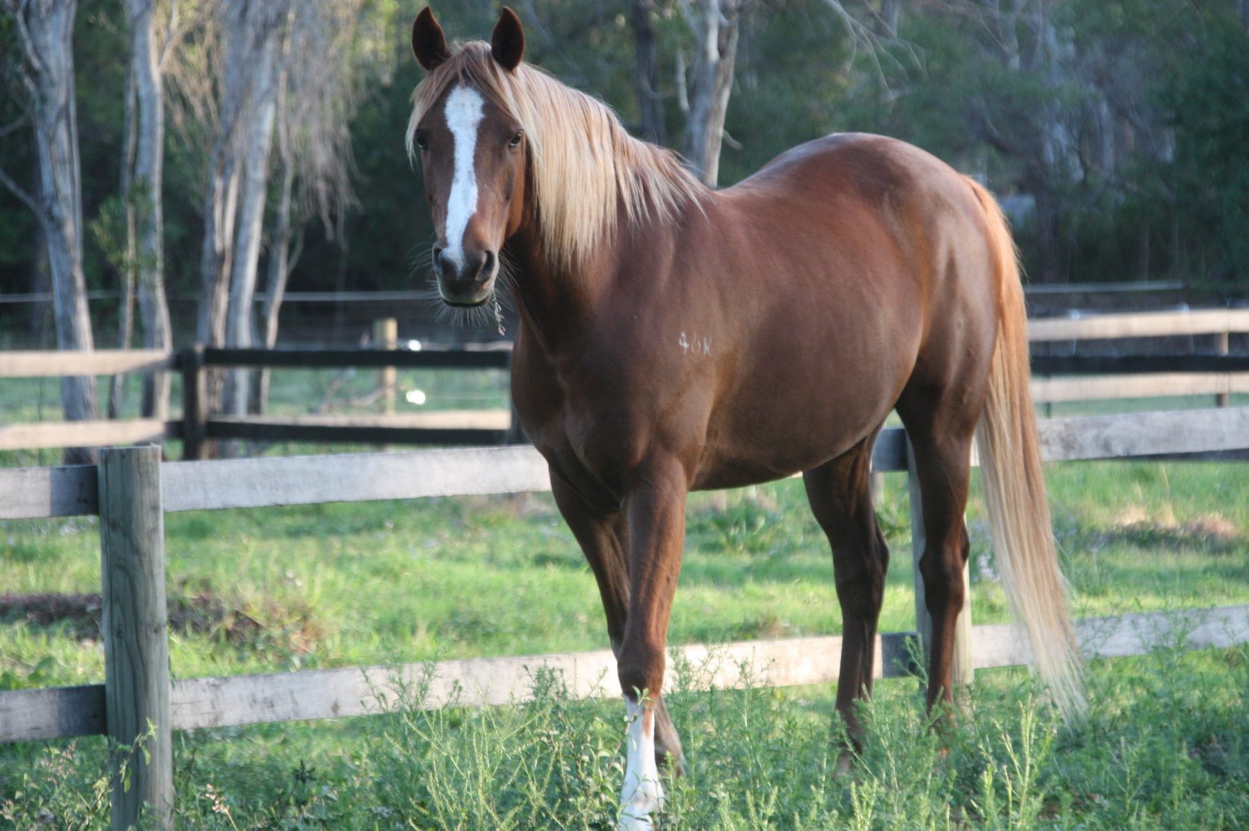
Jum Jum Spirit – a truly wonderful friend

Slide 8


Slide 9
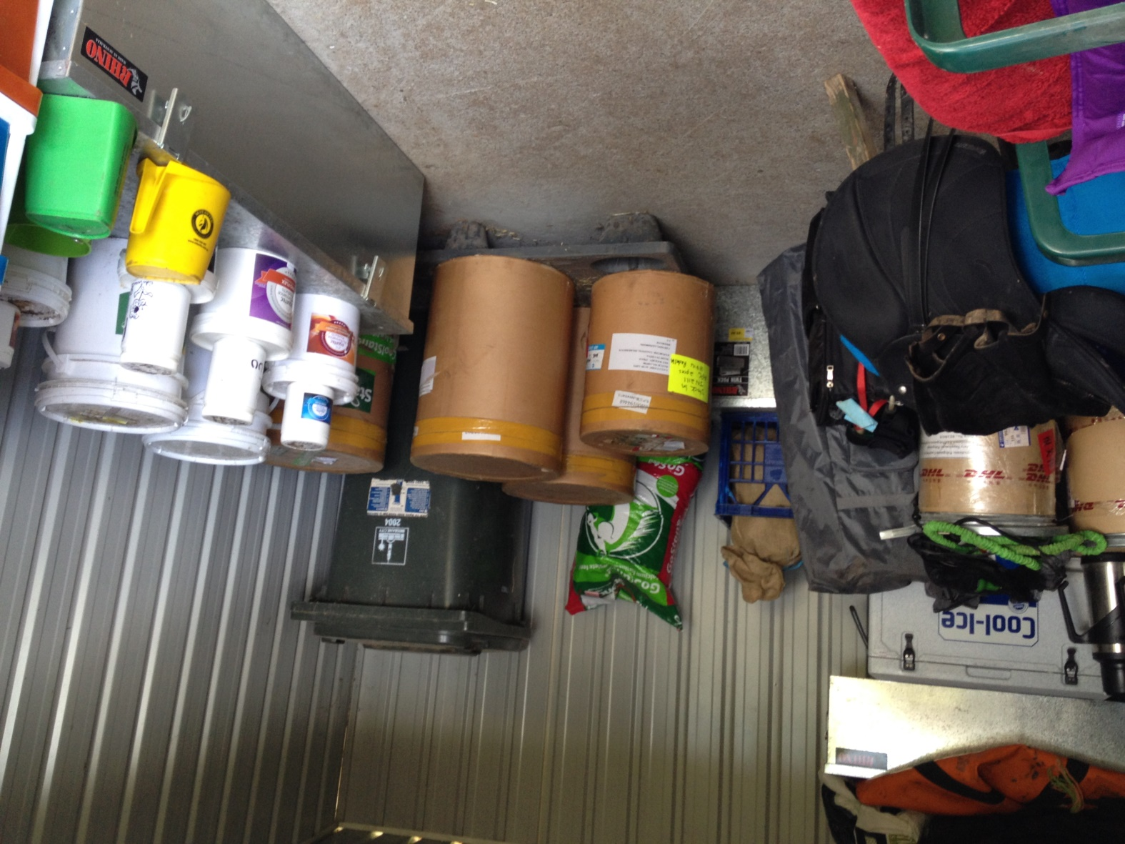
Feed shed
No grain
Oil
Fibre
Natural supplements

Slide 10
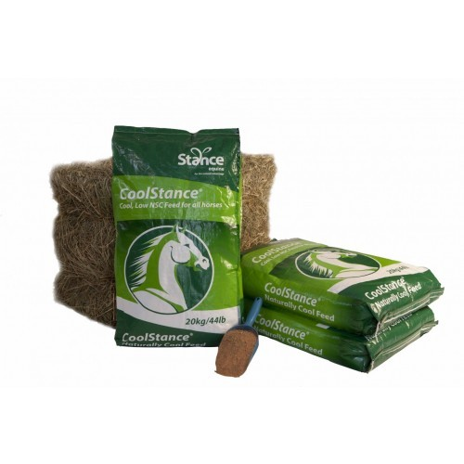
CoolStance
Premium Copra Meal
• Grain replacer
Conditioning, weight gain, coat shine and hoof health
The only all natural high energy low sugar feed in the world.
Feeds over 100,000 horses in
20 countries

Slide 11
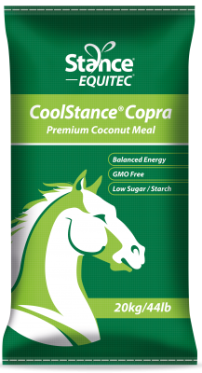
CoolStance
High energy from oil
Low sugar and starch
Chemical and GMO free
12% sugar and starch
15 MJ Digestible energy
11% oil
Feed 1-3kg/day

Slide 12
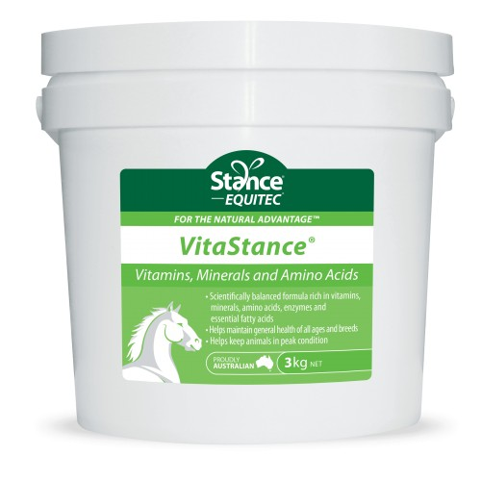
VitaStance®
Vitamins, Minerals and Amino Acids
• Balance CoolStance (low calcium)
• General health of all ages and breeds
• Helps keep animals in peak condition

Slide 13
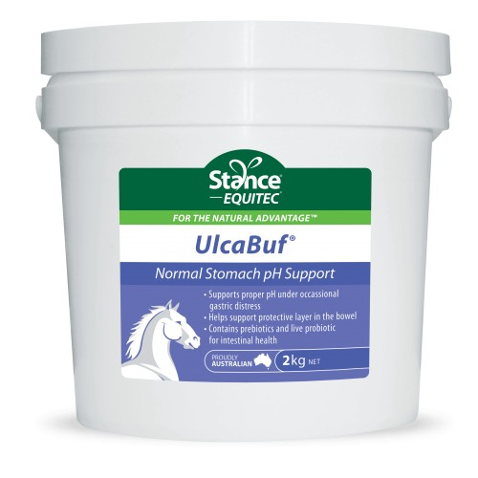
UlcaBuf®
Stomach ulcers and Hindgut acidosis
• Supports proper pH
• Helps support protective layer in the stomach
• Contains prebiotics and live probiotic for intestinal health
Totally drug free

Slide 14
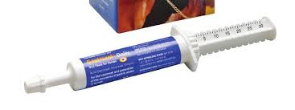
Costings
GastroGuard (Omeprazole)
  10 g/day for 14 days then
  5 g/day for 30 days plus
  $60 for 30 ml tube
  $20 /day
UlcaBuf
  80 g/day
  $300/10kg
  $2.40/day

Slide 15
UlcaBuf
Use UlcaBuf as prophylactic (feed twice per day)
  (to support normal intestinal pH)
Aimed at both
  Stomach ulcers
  Hind gut acidosis
Use Omeprazole in high stress events
(single dose not with feed)

Slide 16
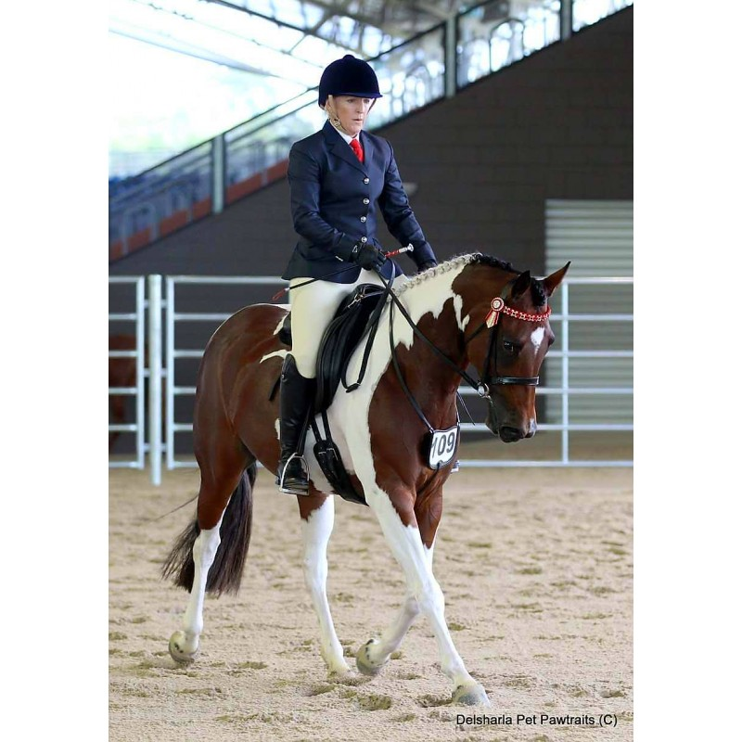
UlcaBuf®
After 2 weeks
My dragon is now a pussy cat

Slide 17
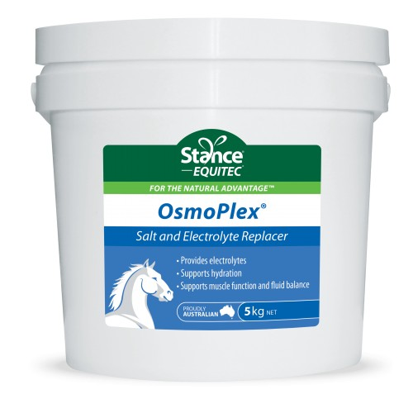
OsmoPlex
Salt and Electrolyte Replacer
Provides electrolytes
Supports hydration
Supports muscle function and fluid balance
Promotes sweating/ anhydrosis

Slide 18
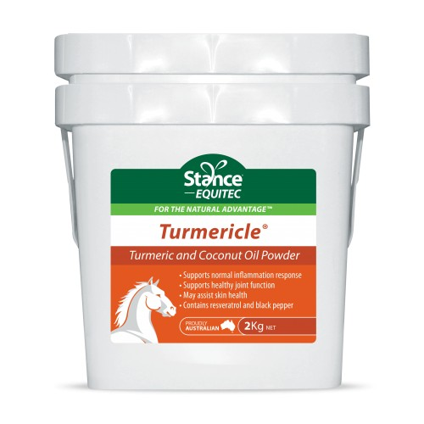
Turmericle®
Turmeric and Coconut Oil Powder
• Supports normal inflammation response
• Supports healthy joint function
• May assist skin health (sarcoids)

Slide 19
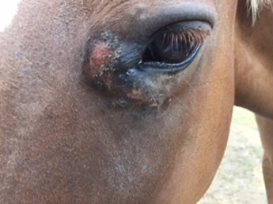
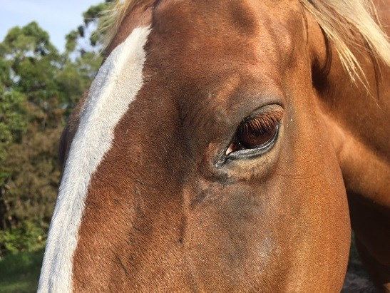
Meg Sarcoid
fed Turmericle for 6 weeks

Slide 20
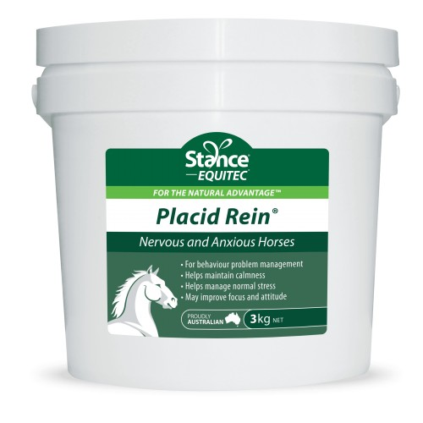
Placid Rein®
Nervous and Anxious Horses
• Behaviour problem management
• Maintain calmness
• Manage normal stress
• Improve focus and attitude

Slide 21
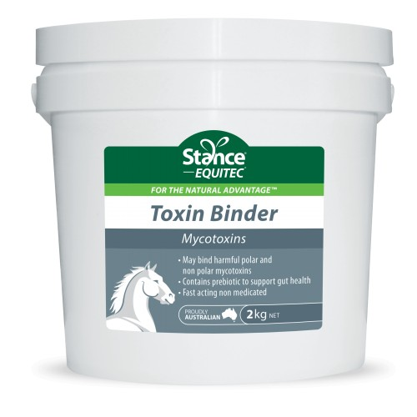
Toxin Binder
Mycotoxins/ Aflatoxins
• Present in pasture, hay, weeds
Binds mycotoxins
Contains prebiotic to support gut health
See results in 7 days

Slide 22
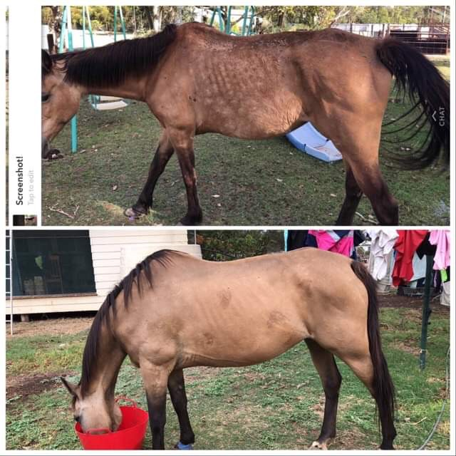
Toxin Binder after 7 days

Slide 23
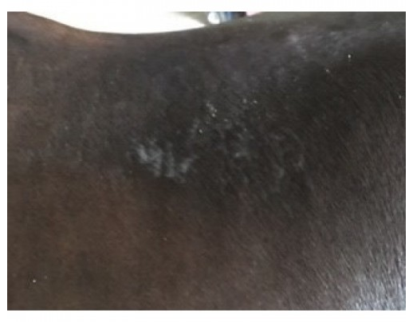
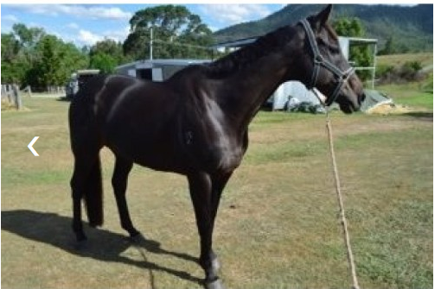
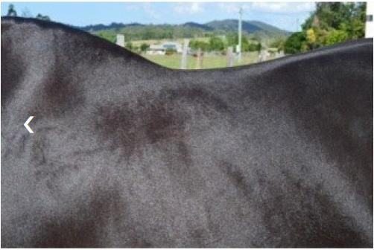
Toxin Binder
Improved skin condition
Improved temperament

Slide 24
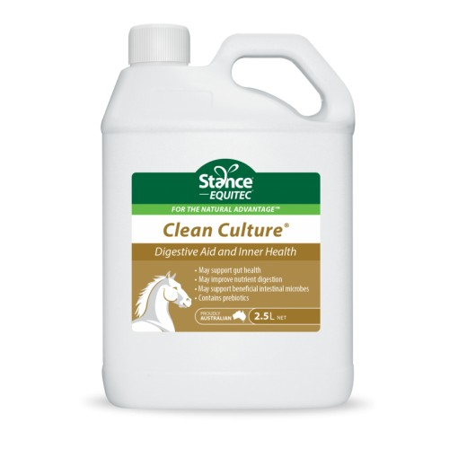
Clean Culture®
Digestive aid and Inner Health
• Gut health
• Improve nutrient digestion
• Beneficial intestinal microbes
• Contains prebiotics

Slide 25
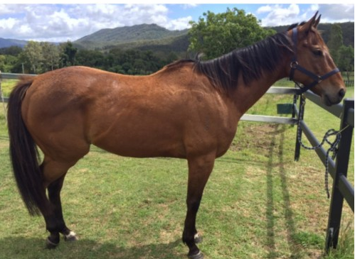
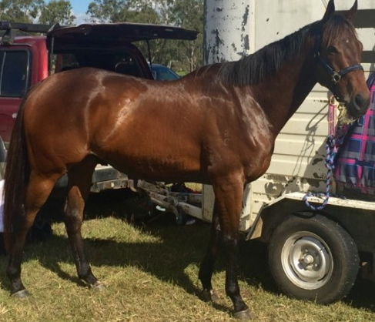
Clean Culture®
Fortune OTT

Slide 26
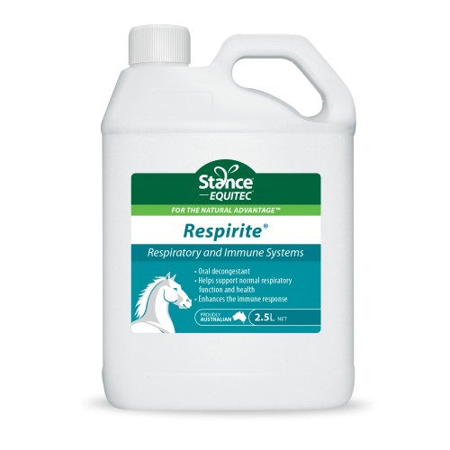
Respirite®
Respiratory and Immune Systems
• Oral decongestant
• Helps support normal respiratory function
• Enhances the immune response

Slide 27
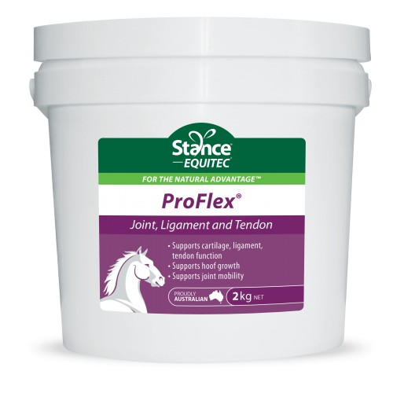
ProFlex®
Joint, ligament and tendon
• Supports cartilage, ligament, tendon function
• Supports hoof growth
• Supports joint mobility

Slide 28
10% Discount coupon
VDALE

